Slide 1
Why hydrogen?
Theo Fens
Delft University of Technology
IDIC/EDI online seminar hydrogen, September 2020

Slide 2
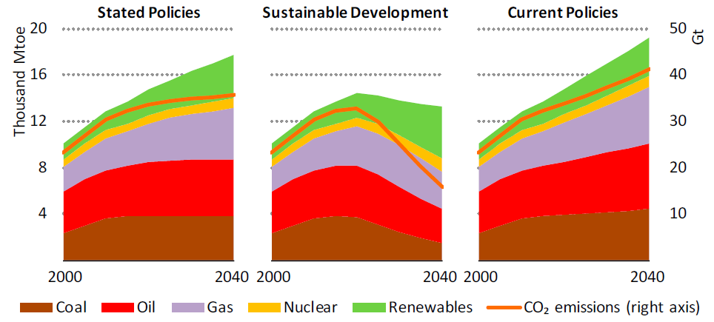
World primary energy demand by fuel and related CO₂ emissions by scenario
Paris 2 ˚C: 37 GT CO₂
Paris 1.5 ˚C: 15 GT CO₂
Business as usual: 42 GT CO₂
Hydrogen plays a key role in this scenario.
So we need to limit the temperature rise to 1.5 ˚C, going from the Stated Policies towards the Sustainable Development.
2
Source: IEA WEO 2019 https://www.iea.org/reports/world-energy-outlook-2019

Slide 3
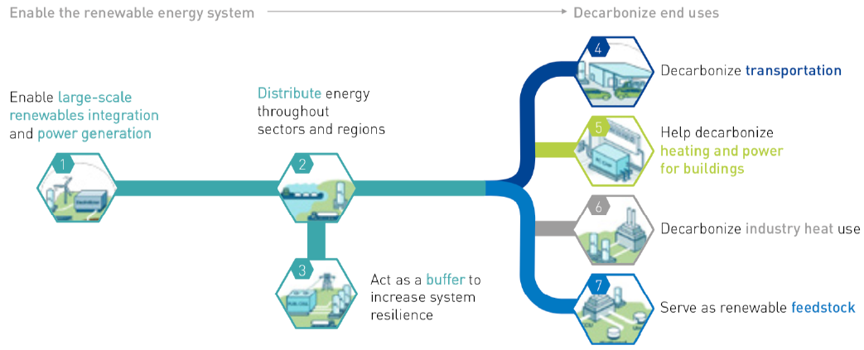
Hydrogen as an enabler for the energy transition
Transporting green hydrogen utilising natural gas network infrastructure.
Mobility sector
This has been recognized by the EU…..
Build environment sector
Green power provides green hydrogen.
Industry sector
Storage of green hydrogen utilizing natural gas storage infrastructure.
3
Source: FCH JU 2019 https://www.fch.europa.eu/publications

Slide 4
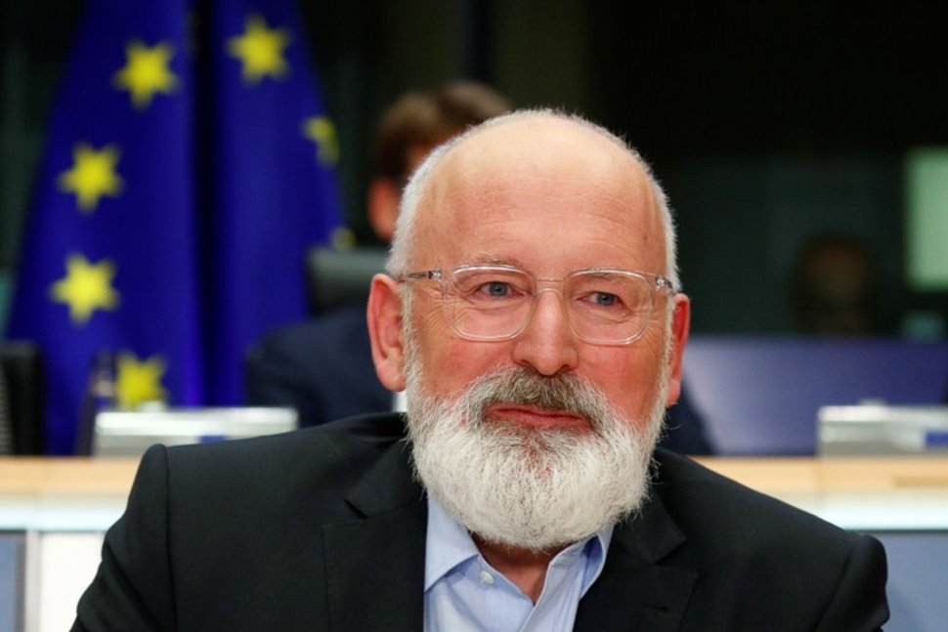
Massive plans: the EU green deal with a role for hydrogen
Video on hydrogen plans EU: https://www.euronews.com/2020/07/10/explainer-why-is-the-eu-commission-betting-on-hydrogen-for-a-cleaner-future
Video on hydrogen plans EU: https://www.euronews.com/2020/07/10/explainer-why-is-the-eu-commission-betting-on-hydrogen-for-a-cleaner-future
4
Source: Hydrogen Strategy 2020- https://ec.europa.eu/energy/sites/ener/files/hydrogen_strategy.pdf

Slide 5
And massive studies on hydrogen…
Video by Hydrogen Europe https://www.youtube.com/watch?v=AVen7ixa2VM
Hydrogen is already used in the industry sector. Is the use of hydrogen in other sectors such as the built environment and mobility, a new phenomenon?
Implementation requires institutional arrangements: rules and regulations…..
Video by Hydrogen Europe https://www.youtube.com/watch?v=AVen7ixa2VM
5
Source: Hydrogen Europe 2019
https://www.hydrogeneurope.eu/

Slide 6
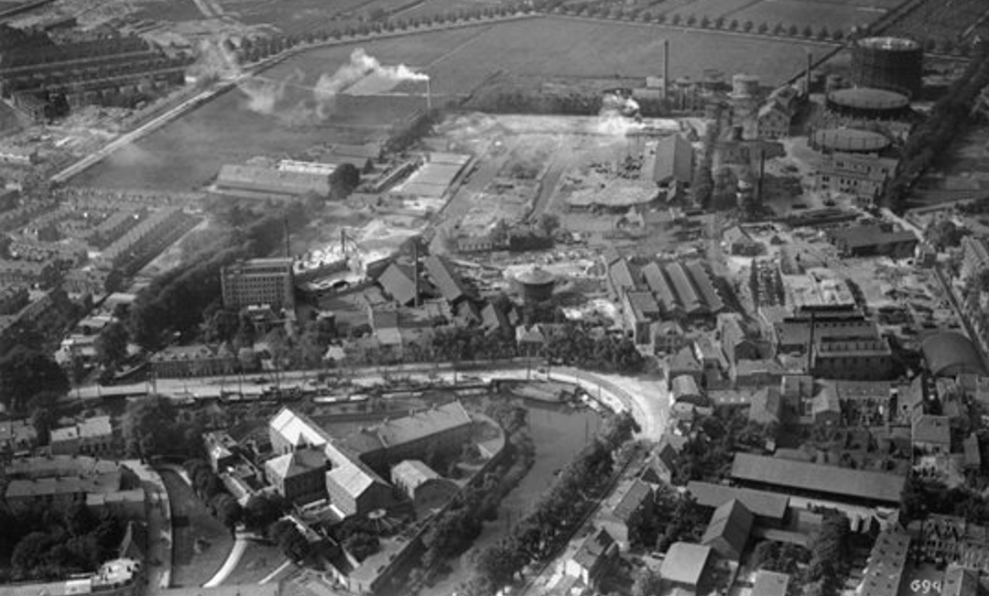
Town Gas production Utrecht 1862-1959
Town gas produced from coal often contained > 50% hydrogen.
6
Source: Wikipedia https://nl.wikipedia.org/wiki/Gemeentelijke_Gasfabriek_(Utrecht)#:~:text=Voor%201862%20betrok%20men%20in,benodigde%20netwerk%20van%20gasleidingen%20aan.

Slide 7
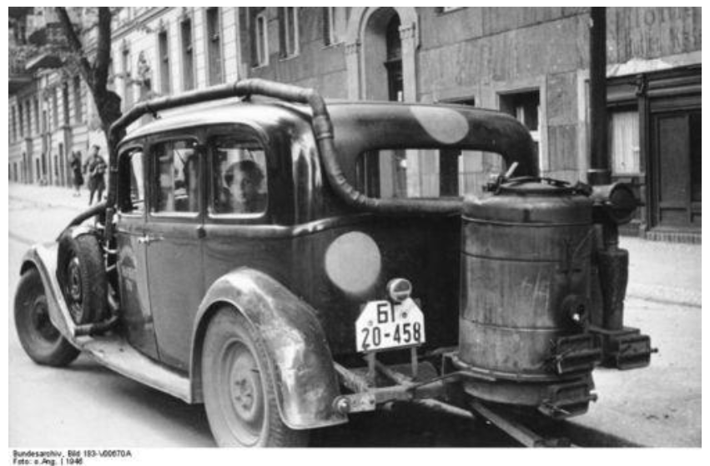
Wood gasification in mobility
Wood gasification car used during World War II.
7
Source: Lowtech Mgazine https://www.lowtechmagazine.be/2010/01/houtgas-als-alternatieve-brandstof-voor-autos.html

Slide 8
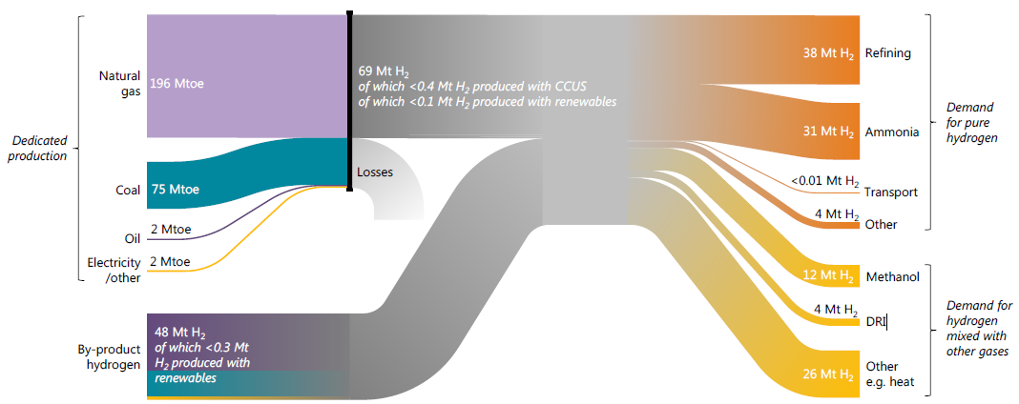
The hydrogen resource chain, production and use 2019
Currently < 1% green…
Currently < 1% green…
Direct Reduction Iron steel
8
Source: IAE WEO 2019 https://www.iea.org/reports/world-energy-outlook-2019

Slide 9
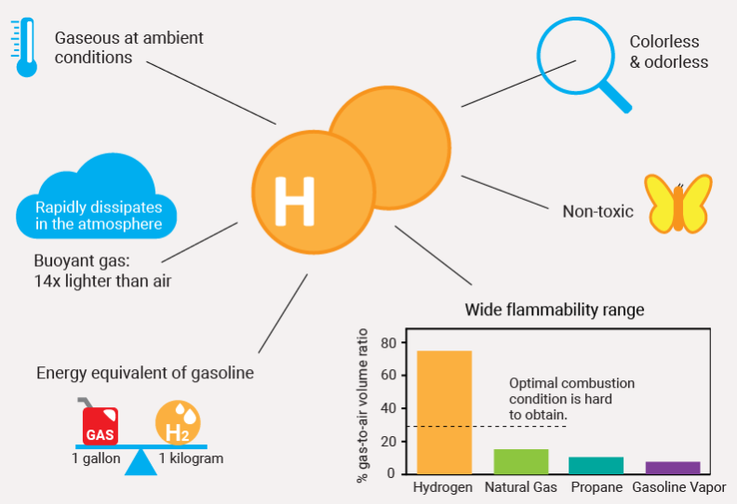
Hydrogen safety and handling
Video on hydrogen safety: https://www.youtube.com/watch?v=6cMCO37A1jY
Remarks: When a conventional hydrocarbon fuel burns, it produces hot ash from the oxidation of carbon, creating radiant heat.
This is not the case with hydrogen because it does not contain carbon. In its pure form, hydrogen burns and produces no hot ash and very little radiant heat.
However, a hydron flame is nearly invisible compared to a natural gas flame.
Video on hydrogen safety: https://www.youtube.com/watch?v=6cMCO37A1jY
9
Source: Hydrogen station maps 2020 https://h2stationmaps.com/hydrogen-stations#safety

Slide 10
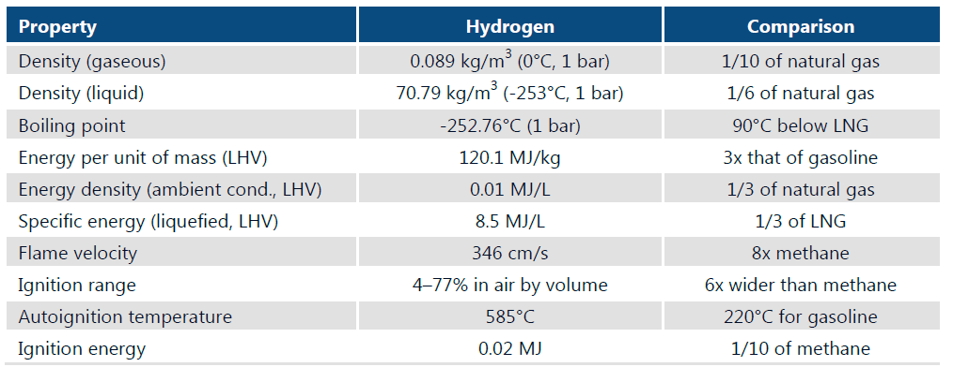
Characteristics hydrogen compared to natural gas
Video on hydrogen characteristics https://www.youtube.com/watch?v=Kv8WT3-7ZHE
Notes: cm/s = centimetre per second; kg/m3 = kilograms per cubic metre; LHV = lower heating value; MJ = megajoule; MJ/kg = megajoules per kilogram; MJ/L = megajoules per litre.
Video on hydrogen characteristics https://www.youtube.com/watch?v=Kv8WT3-7ZHE
10
Source: EIA 2019 https://www.iea.org/reports/the-future-of-hydrogen

Slide 11
End use applications, energy value chain NL example
---> hydrogen
Gas
exploration
Gas
appraisal
Gas
production
Gas Trade
Gas
Transmission
Gas Electricity Heat Distribution
Gas Electricity Heat Metering
Gas Electricity Heat B2B/B2C Retail
Customer
Green gas
production
Gas Trade
Gas
Transmission
Gas Electricity Heat Distribution
Gas Electricity Heat Metering
Gas Electricity Heat B2B/B2C Retail
Green gas
production
Local G production
Geothermal
exploration
Geothermal
appraisal
Geothermal
production
Heat Trade
Local H production
waste heat
production
Fuel
production
Local E production
Fuel
production
Large scale Electricity
production
Electricity
Trade
Electricity
Transmission
Large scale Electricity
production
Electricity
Trade
Electricity
Transmission
Renewables
Regulated
Open market
11
Government roles: policy maker, regulator, share holder, taxes, governance subsidies, dividend receiver

Slide 12
Thank you for your attention
12

Slide 13
Backup sheets
13

Slide 14
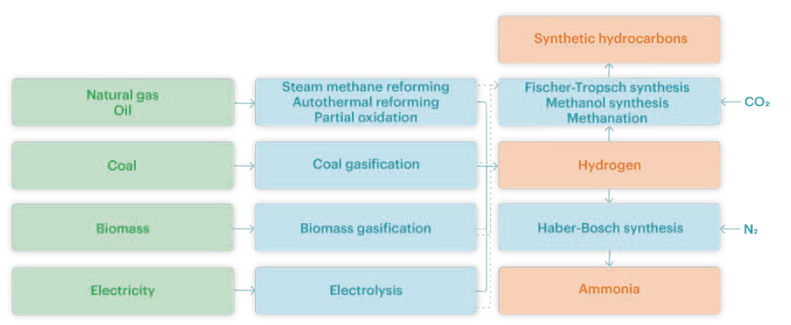
Potential pathways for producing hydrogen and hydrogen-based products
14
Source: EIA 2019 https://www.iea.org/reports/the-future-of-hydrogen

Slide 15
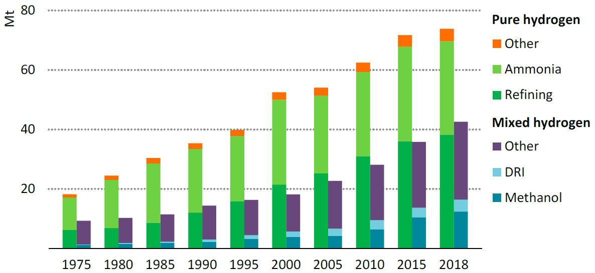
Historic global annual demand for hydrogen
Notes: DRI = direct reduced iron steel production. Methanol, DRI and “other mixed” represent demand for
applications that use hydrogen as part of a mixture of gases, such as synthesis gas, for fuel or feedstock.
Around 70 Mt of hydrogen is used today in pure form; a further 45 Mt is used in industry without prior separation from other gases.
15
Source: IAE WEO 2019 https://www.iea.org/reports/world-energy-outlook-2019

