Slide 1
Production, transport, storage of hydrogen, the economics
Theo Fens
Delft University of Technology
IDIC/EDI online seminar hydrogen, September 2020

Slide 2
Green hydrogen: electrolysers and fuel cells
2
Source: Hydrogenics 2019 https://www.hydrogenics.com/

Slide 3
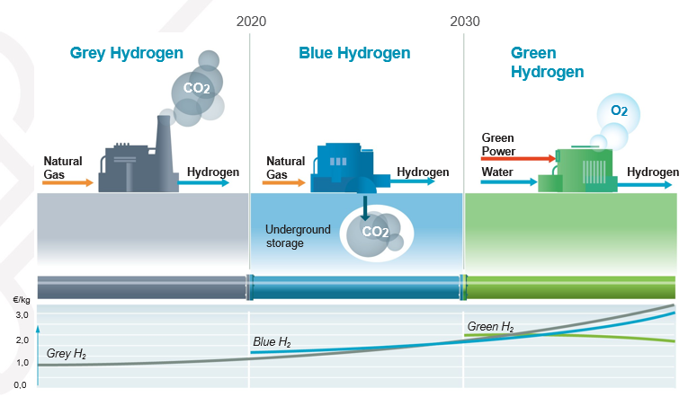
Hydrogen colours, from Grey to Green, the economics
3
Source: ECN/TNO 2019 https://www.tno.nl/en/focus-areas/energy-transition/roadmaps/towards-co2-neutral-fuels-and-feedstock/hydrogen-for-a-sustainable-energy-supply/

Slide 4
Levelised cost of green hydrogen from electrolysers
$$LCOH=\frac{LCCO}{Util}+LCOE ∗ Eff$$
Symbol | Definition | Unit
LCOH | Levelized Cost of Hydrogen | €/kg H₂
LCCO | Levelized cost of Capital and fixed Opex at 100% utilization | €/kg H₂
Util | Utilization rate of the electrolyser | % of the time
LCOE | Levelized cost of electricity | €/kWh_{e}
Eff | Efficiency of the electrolyzer | kWh_{e}/kg H₂
Green hydrogen requires green power, how about the LCOE of renewables?
4
Source: Hydrogenics 2019 https://www.hydrogenics.com/

Slide 5
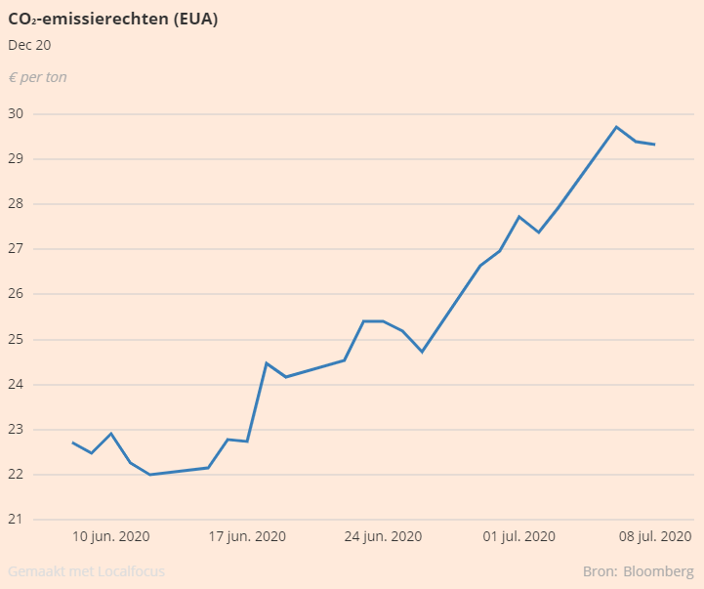
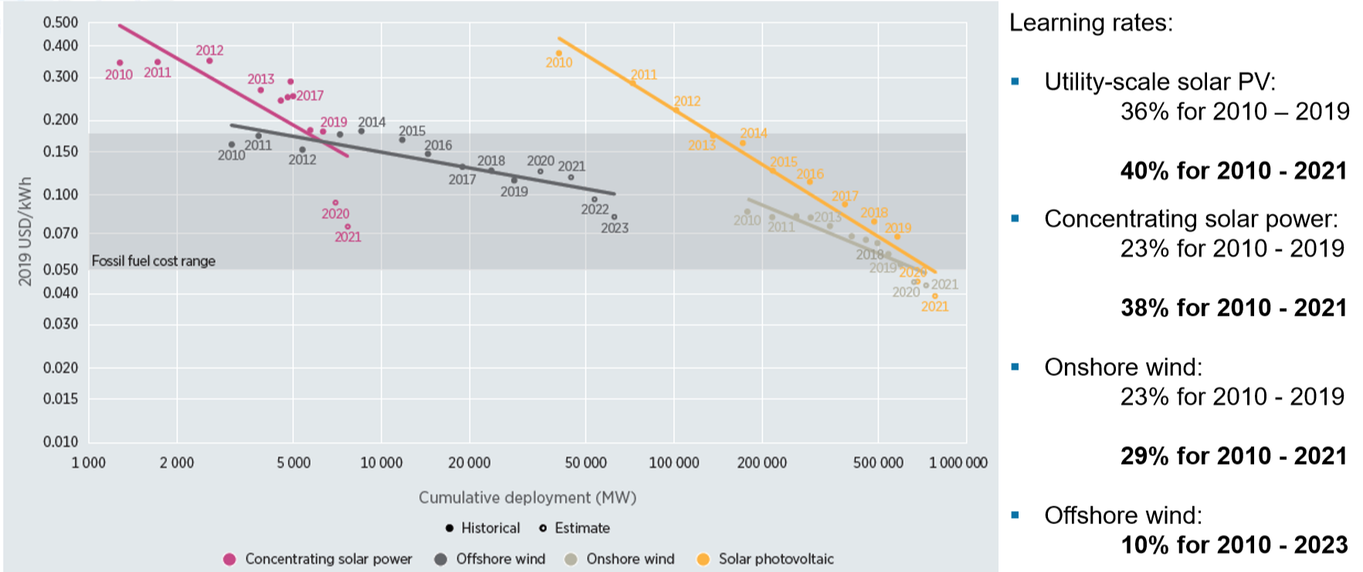
Levelised cost of renewable electricity in $/kWh, OPEX of green hydrogen…..
Green hydrogen from green power, options transport and storage?
This band moves up when the CO₂ price increases.
5
Source: Irena June 2020 https://www.irena.org/-/media/Files/IRENA/Agency/Webinars/2020/Jun/IRENAinsight-webinar_RPGC-in-2019-Overview.pdf?la=en&hash=80A08A29C8807989DC9DBA8E78E55B6124DC5E42

Slide 6
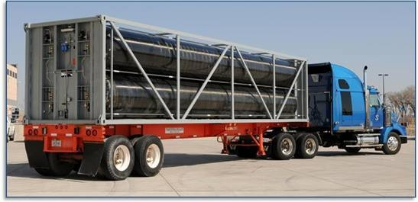
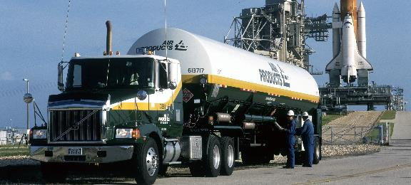
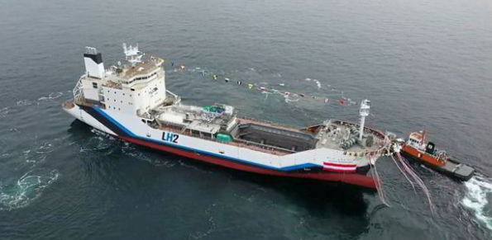
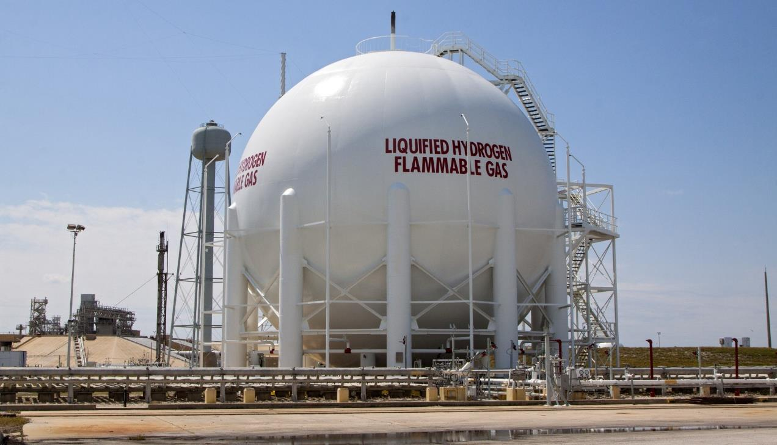
Transport & Storage of hydrogen: the options
70 m
Transport
Pipelines (network)
Trucks (tube trailer)
Trucks (liquid)
Ships (liquid)
Storage
Salt caverns
Gas fields
Tubes (trailer)
Sphere (liquid)
State
Gas (up to 700 Bar)
Liquid (-253 ˚C)
Other energy carriers
Ammonia (NH₃)
Liquid Organic Hydrogen Carrier (LOHC)
300 m
Production -> transport/storage -> end user: A hydrogen value chain?
Depth 1000 m
6

Slide 7
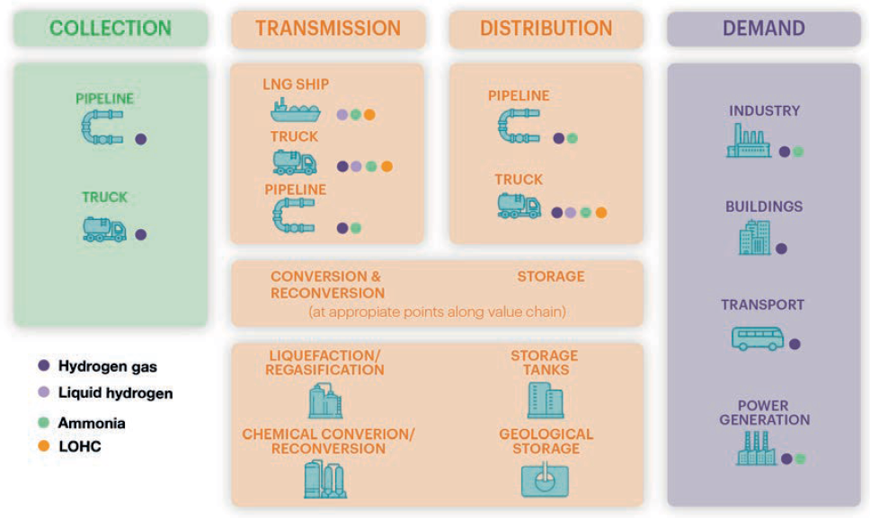
Elements of the hydrogen value chain
Note: LOHC = liquid organic hydrogen carrier.
How about the transport economics?
Various modes of hydrogen transport are possible: gas, liquid, ammonia, LOHC. The choice depends on distance, volume and end use.
7
Source: EIA 2019 https://www.iea.org/reports/the-future-of-hydrogen

Slide 8
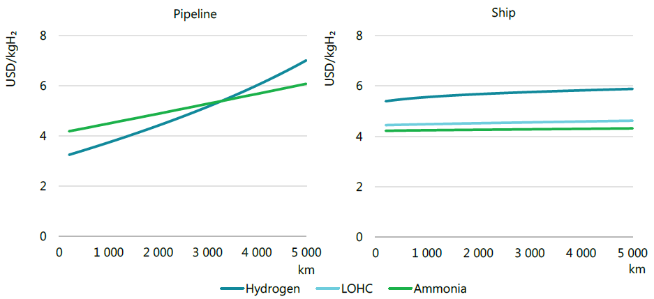
Full cost of hydrogen delivery to the industrial sector by pipeline or ship in 2030 for different transmission distances
Notes: Hydrogen production cost = USD 3/kgH₂; assumes distribution of 100 tpd in a pipeline to an end-use site 50 km from the
receiving terminal.
Delivering hydrogen to the industrial sector is cheaper by pipeline for transport over shorter distances; above a certain distance shipping is a cheaper option.
8
Source: EIA 2019 https://www.iea.org/reports/the-future-of-hydrogen

Slide 9
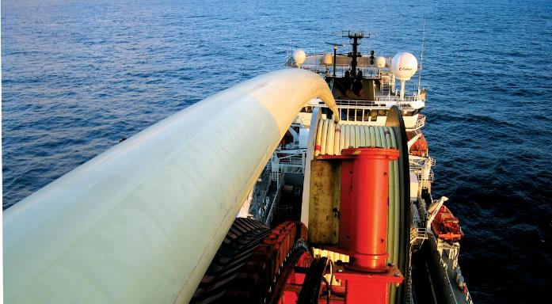
Transport of gas is much cheaper and more efficient than transport of electricity
Power
Unavoidable physical losses
Gas
Leak-free: no losses
260 km
€ 600 mio
1 GW capacity
€ 230/kW/100 km
230 km
€ 500 mio
20 GW capacity
€ 11/kW/100 km
€ 9/kW/100 km
Does hydrogen gas infrastructure require a new technology?
Offshore wind farms at GW scale: the combination of local conversion of power to hydrogen + a pipeline system may well be cheaper than a GW scale cable….certainly when current gas infrastructure is used.
9

Slide 10
Existing hydrogen pipelines
Air products Air Liquide
These are industrial dedicated regional hydrogen networks, how about the hydrogen plans of the gas TSO’s?
10

Slide 11
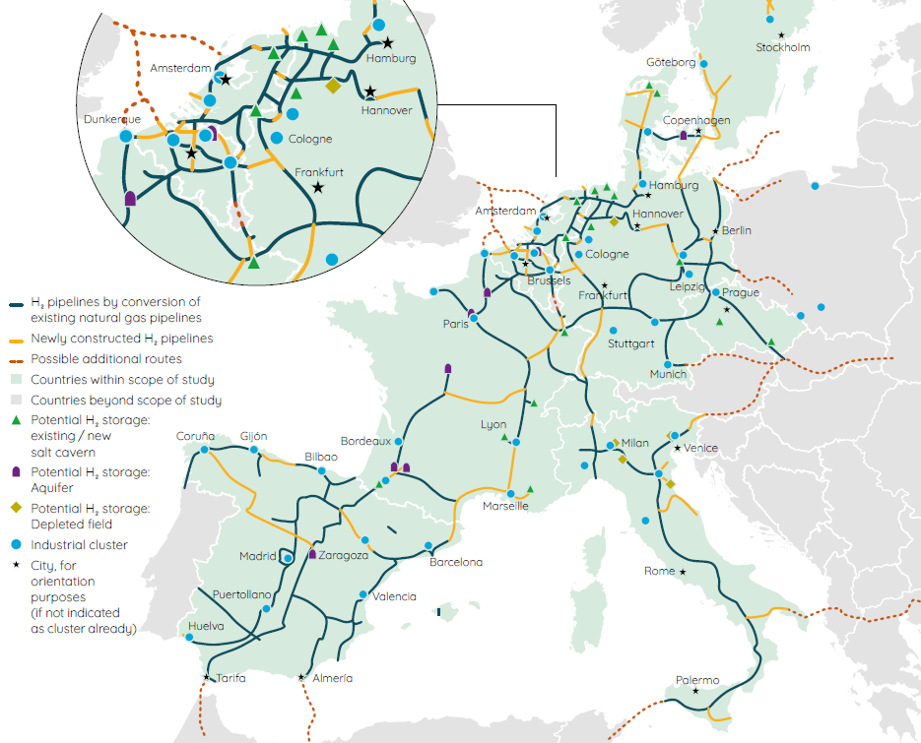
EU TSOs gas: European hydrogen infrastructure backbone
Video hydrogen gas transmission line by Gasunie https://www.youtube.com/watch?v=a7iPqEdJ95s
A group of EU TSOs (Enagás, Energinet, Fluxys Belgium, Gasunie, GRTgaz, NET4GAS, OGE, ONTRAS, Snam, Swedegas (Nordion Energi), Teréga)
from nine EU member states presented on a plan to create a dedicated hydrogen pipeline network of almost 23,000 km by 2040, to be used in parallel to the natural gas grid.
This TSO network is intended for 100% hydrogen, what is the story on blending with natural gas?
Video hydrogen gas transmission line by Gasunie https://www.youtube.com/watch?v=a7iPqEdJ95s
11
Source: Gas for climate July 2020 https://gasforclimate2050.eu/sdm_downloads/european-hydrogen-backbone/

Slide 12
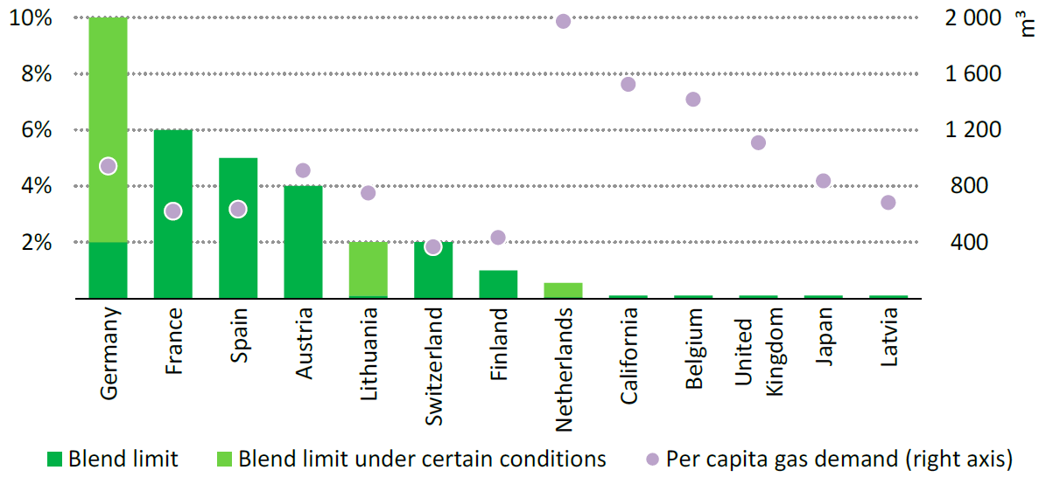
Current limits on hydrogen blending in natural gas networks and gas demand per capita in selected locations
Today most natural gas networks have limits on allowable hydrogen concentrations;
some with the strictest limits have the highest per capita natural gas demand.
12
Source: IAE WEO 2019 https://www.iea.org/reports/world-energy-outlook-2019

Slide 13
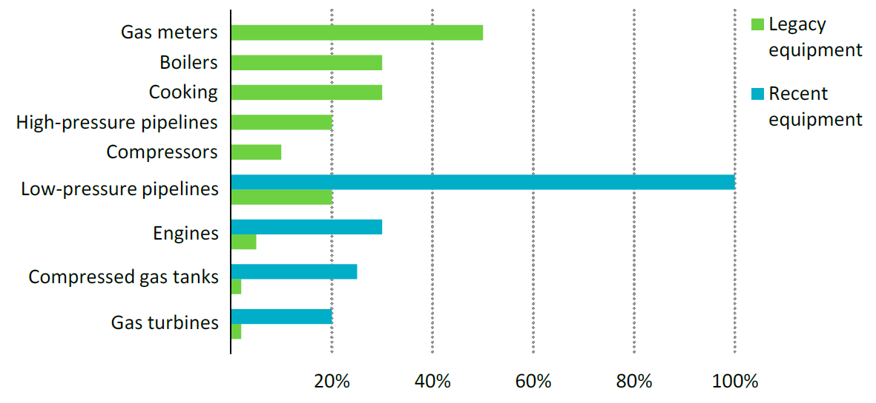
Estimated tolerance to hydrogen blend shares of selected elements of existing gas distribution networks
Much existing equipment would need to be adapted to tolerate meaningful levels of
blending or be replaced by new equipment designed to tolerate pure streams of hydrogen.
13
Source: IAE WEO 2019 https://www.iea.org/reports/world-energy-outlook-2019

Slide 14
Thank you for your attention
14

Slide 15
Backup sheets
15

Slide 16
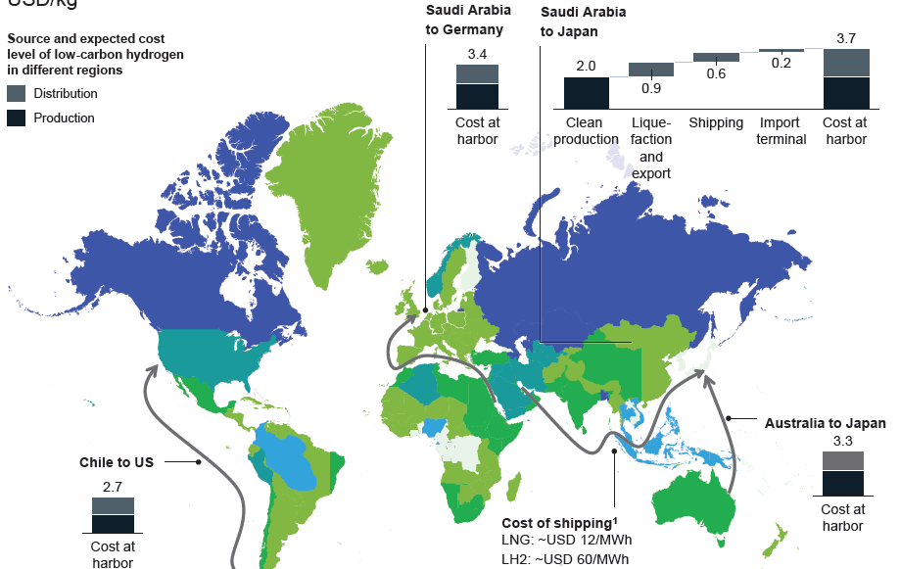
Cost of shipping liquid hydrogen across regions 2030, $/kg
Source: Hydrogen Council, Path-to-Hydrogen-Competitiveness _Full-Study-1 2019
https://hydrogencouncil.com/en/path-to-hydrogen-competitiveness-a-cost-perspective/
16

Slide 17
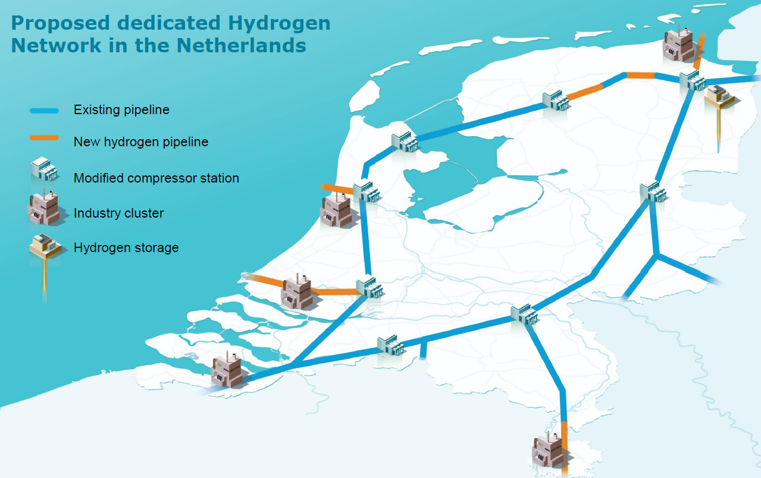
The foreseen Dutch hydrogen grid
17
Source: Gasunie, 2019

Slide 18
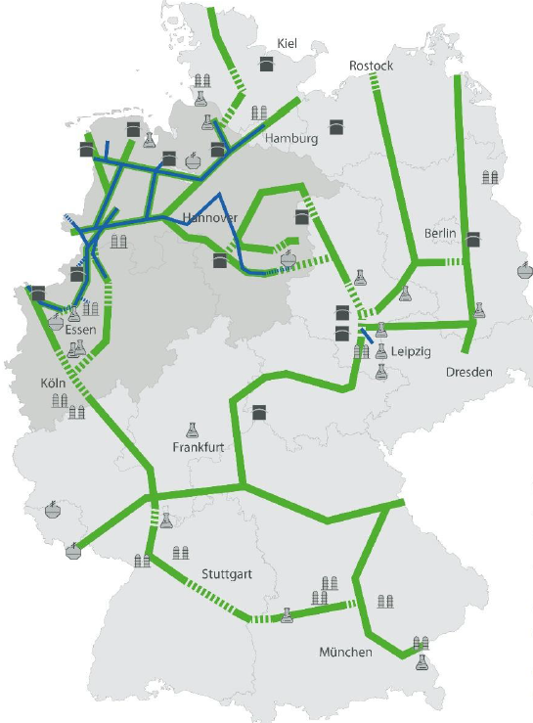
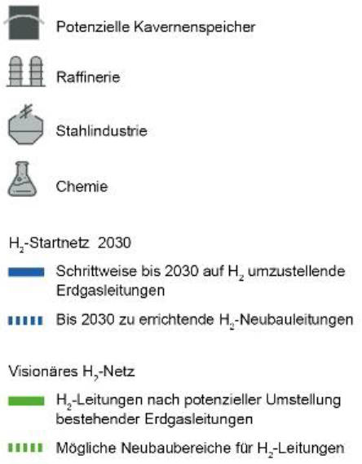
Hydrogen transmission networks in Germany, H₂-Startnetz 2030, 1200 km
Notes: The plans for a hydrogen pipeline network set out in the Gas Network Development Plan (NDP) 2020-2030 have confirmed key elements of the visionary H₂ network of January 2020. A first hydrogen network (H₂ starter network 2030), which is needed to establish a hydrogen economy in Germany, can be developed quickly and at reasonable cost. The Gas NDP consultation document published by the transmission system operators on 4 May 2020 outlines concrete steps for the development of an H₂ network. The first converted pipelines, which are expected to be available as early as the end of 2022, will provide the core of a nationwide H₂ network gradually evolving until 2030 (especially in North Rhine-Westphalia and Lower Saxony).
18
Source: FNBGas May 2020 https://www.fnb-gas.de/fnb-gas/veroeffentlichungen/pressemitteilungen/fernleitungsnetzbetreiber-veroeffentlichen-h2-startnetz-2030/

