Slide 1
End use of hydrogen, mobility, industry, built environment
Theo Fens
Delft University of Technology
IDIC/EDI online seminar hydrogen, September 2020

Slide 2
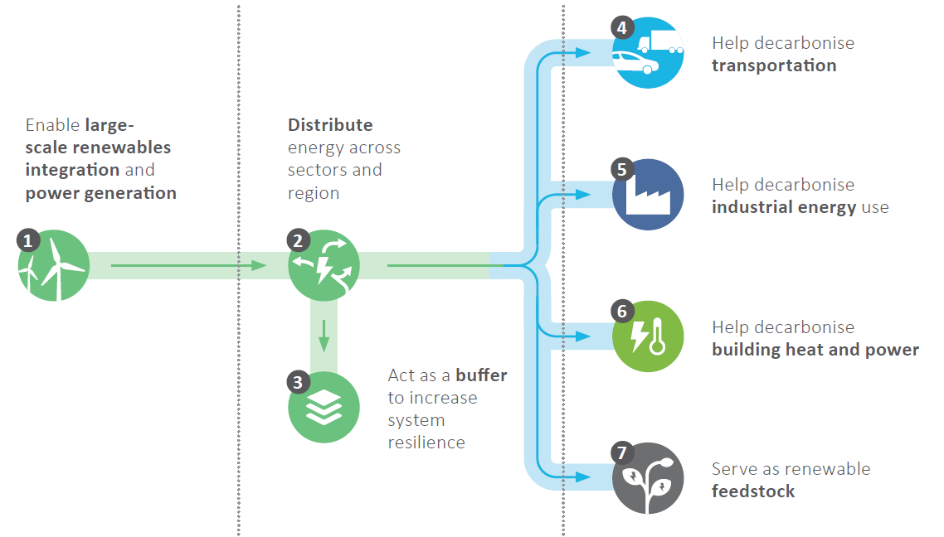
The versatility of hydrogen in end use, sector coupling
Hydrogen couples the sectors mobility, industry, built environment and power.
Transporting green hydrogen storage utilising natural gas network infrastructure
In power hydrogen can mitigate the intermittency of solar and wind: surplus electricity is converted to hydrogen with an electrolyser and stored. When required the stored hydrogen is reconverted to electricity and heat….system integration.
Green power provides green hydrogen
Green hydrogen storage utilising natural gas storage infrastructure
2
Source: hydrogen Europe April 2020
https://www.hydrogeneurope.eu/news/2x40gw-green-hydrogen-initiative-paper

Slide 3
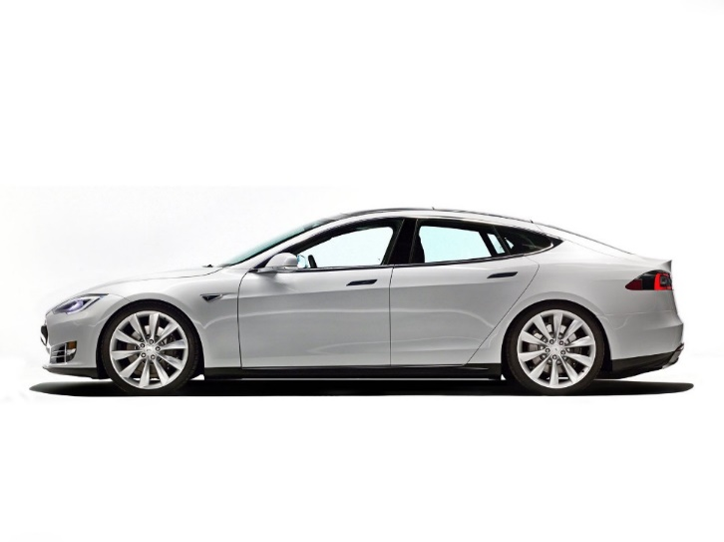
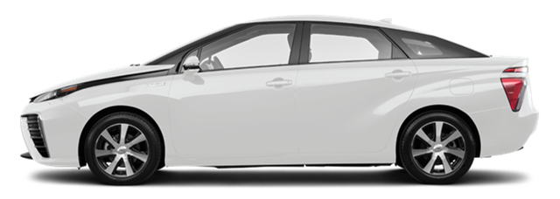
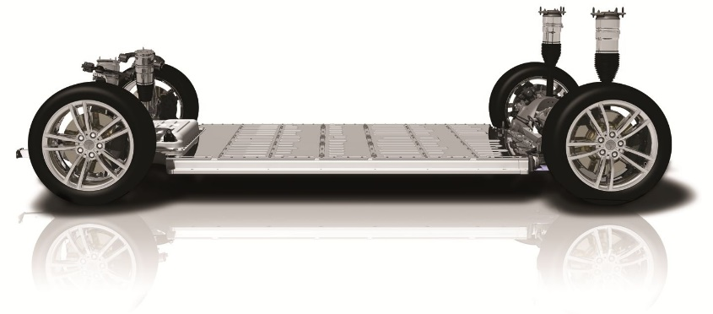

Future mobility will be electric, battery versus hydrogen
Video Toyota Mirai
https://www.youtube.com/watch?v=LSxPkyZOU7E
Tesla Model S
Toyota Mirai
100 kWh battery ~600 kg
Range 475 km
120 kW fast charger, 33 min. 80% fill
Fuel Cell, Hydrogen tanks, battery ~200 kg
5 kg hydrogen; range 500 km
Fuelling station <5 min. 100% fill
3
Video Toyota Mirai
https://www.youtube.com/watch?v=LSxPkyZOU7E
Source: TUD Ad van Wijk, 2017
http://profadvanwijk.com/

Slide 4
Mobility: battery or fuel cell? Or both?
Specific energy
H₂ = 33 kWh/kg
Li-Ion battery = 0.1-0.25 kWh/kg
4
Source: Hydrogen Europe 2020
https://hydrogeneurope.eu/zero-emission-mobility

Slide 5
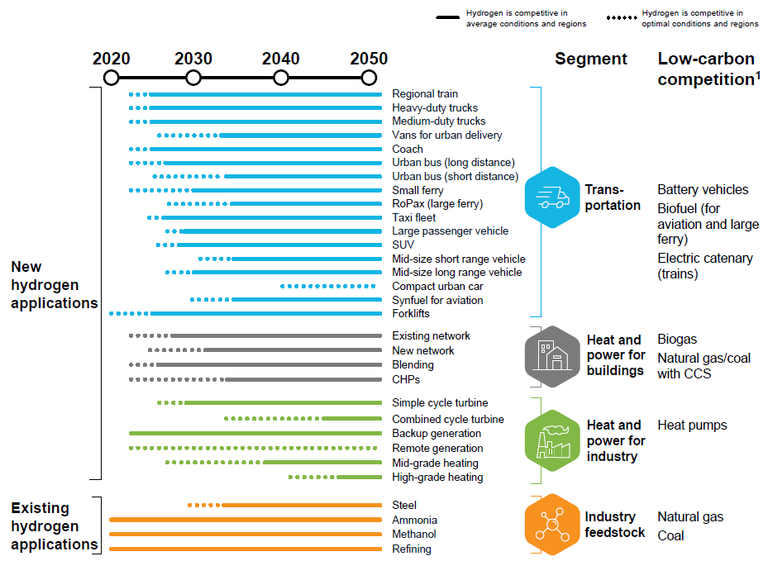
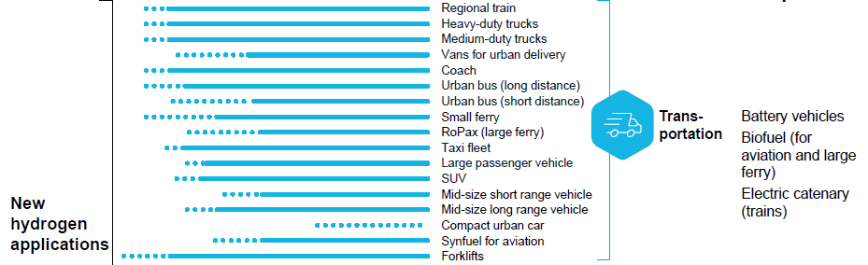
Cost competitiveness trajectories of hydrogen applications
2035
Source: Hydrogen Council,
Path-to-Hydrogen-Competitiveness
_Full-Study-1 2019
https://hydrogencouncil.com/en/path-to-hydrogen-competitiveness-a-cost-perspective/
5

Slide 6
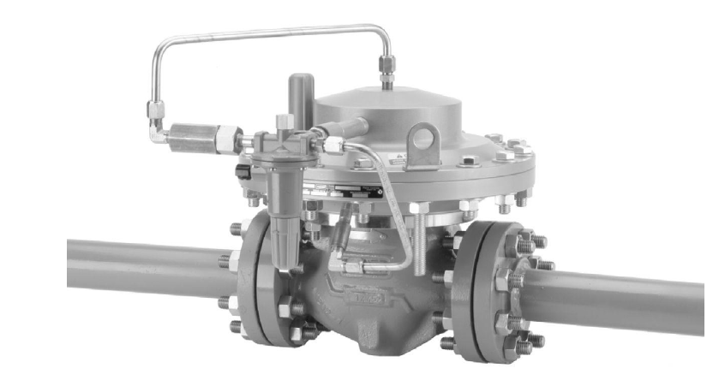
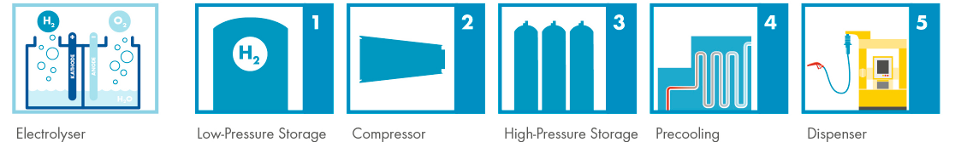
Hydrogen tanking stations, cooling before refuelling your car
Joule-Thomson effect
  Pressure reduction natural gas: -0.5 ˚C/bar
  Pressure reduction hydrogen: +0.035 ˚C/bar
Hydrogen pressure reduction from 80 to 15 bar: +2 ˚C
6
Source: Hydrogen Europe 2020
https://hydrogeneurope.eu/refueling-stations

Slide 7
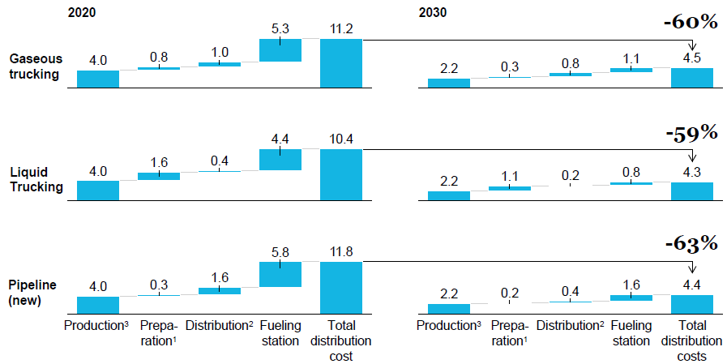
Evolution of hydrogen cost for mobility fueling stations, $/kg
Compression for gaseous trucking, liquefaction for liquid trucking or storage for pipelines.
Gaseous trucking, liquid trucking or pipelines.
Assumes average blue and green production cost in Europe (Germany offshore wind).
Source: Hydrogen Council,
Path-to-Hydrogen-Competitiveness
_Full-Study-1 2019
https://hydrogencouncil.com/en/path-to-hydrogen-competitiveness-a-cost-perspective/
7

Slide 8
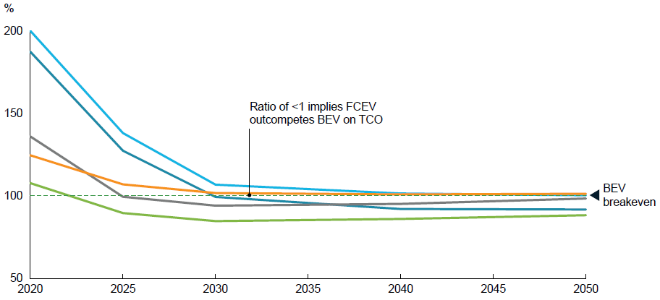

TCO ratio between FCEV/BEV vehicles
No. average of 5 car segments ranging from small and low usage to large and high usage.
Source: Hydrogen Council,
Path-to-Hydrogen-Competitiveness
_Full-Study-1 2019
https://hydrogencouncil.com/en/path-to-hydrogen-competitiveness-a-cost-perspective/
8

Slide 9
Cost competitiveness trajectories of hydrogen applications
2035
Source: Hydrogen Council,
Path-to-Hydrogen-Competitiveness
_Full-Study-1 2019
https://hydrogencouncil.com/en/path-to-hydrogen-competitiveness-a-cost-perspective/
9

Slide 10
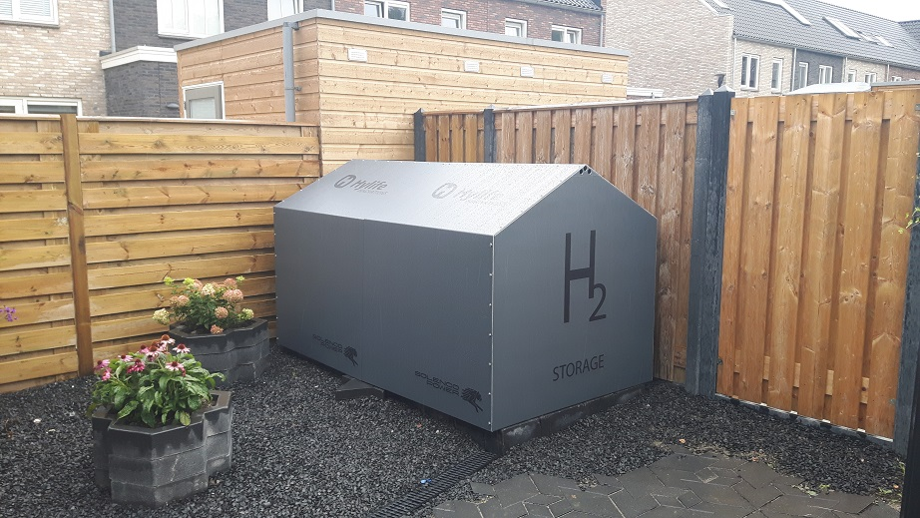
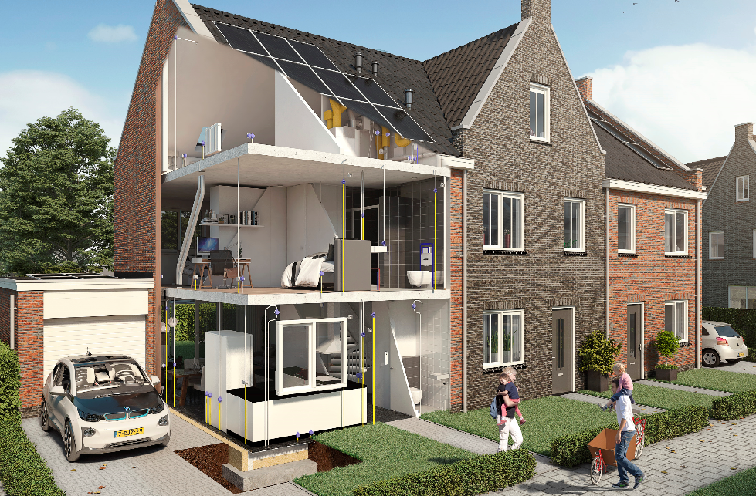
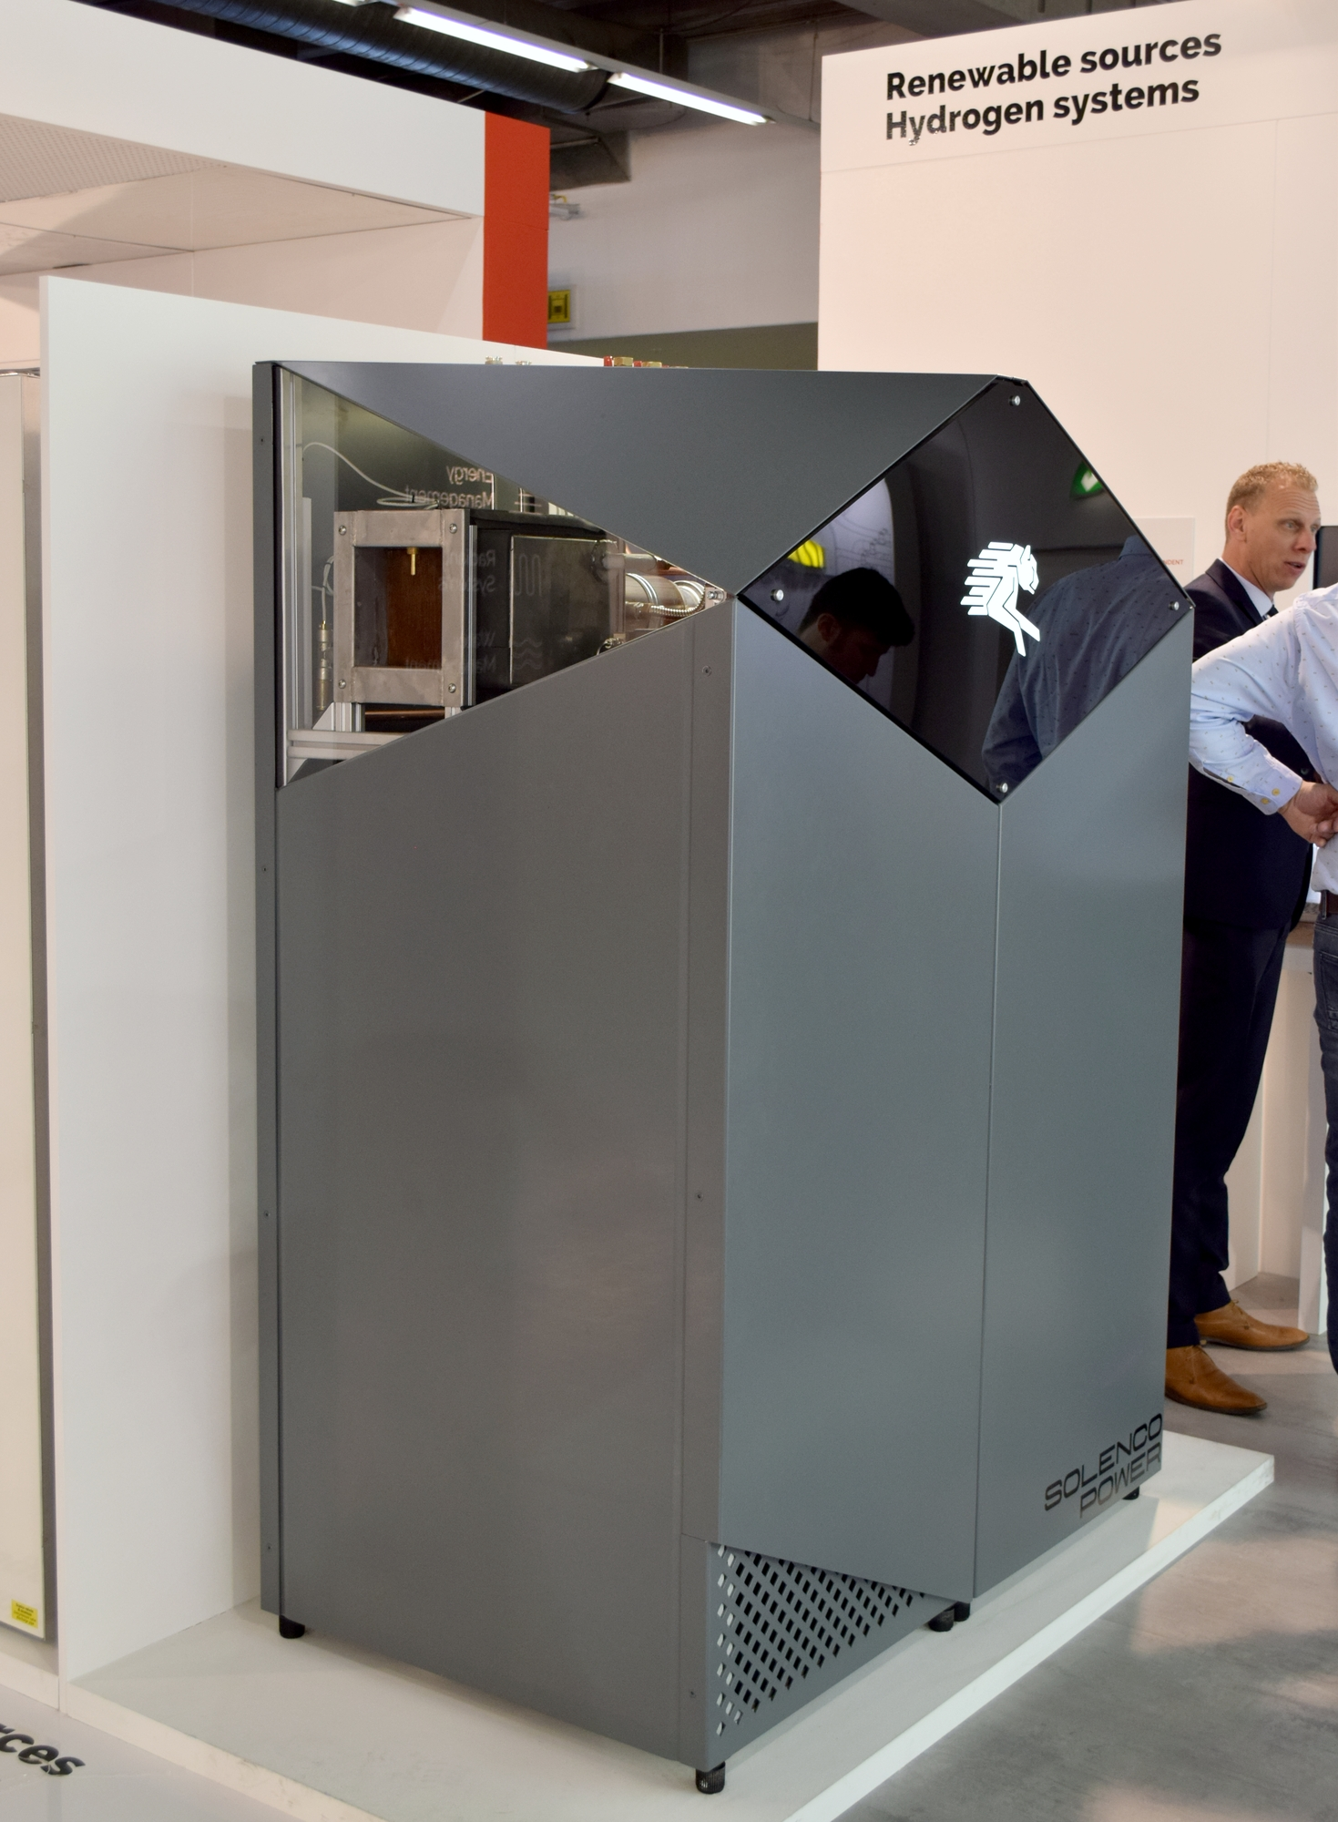
Stad aan ‘t Haringvliet, Het Innovathuis
All required permits granted by June 2020.
New district of 100 houses planned for 2021.
10
Source: https://wonenopflakkee.nl/initiatieven/het-innovathuis/ , 2019

Slide 11
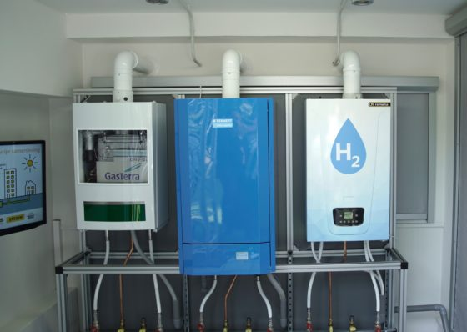
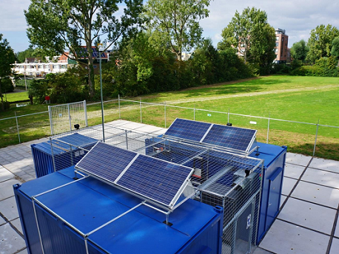
Testing 3 domestic boilers on hydrogen with a power-to-gas project
11
Source: Stedin 2019
https://tvvlconnect.nl/thema/waterstof/blog/91-waterstofverwarming-van-demonstratie-naar-echt

Slide 12
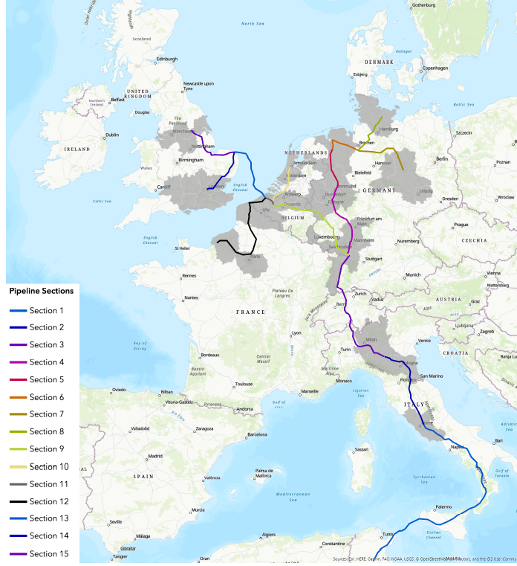

Hydrogen infrastructure EU corridor split up in 15 interconnected sections
The EU Blue Banana corridor is eligible for kick starting the hydrogen economy.
Current industrial hydrogen use
Existing natural gas infrastructure
Salt cavern storage
Population density for hydrogen use in domestics and mobility
12
Source: TUD Jeroen Eble, March 2020
https://repository.tudelft.nl/islandora/object/uuid%3A8b0c8cf7-ac12-4ba1-a604-04dd9f85b39d

Slide 13
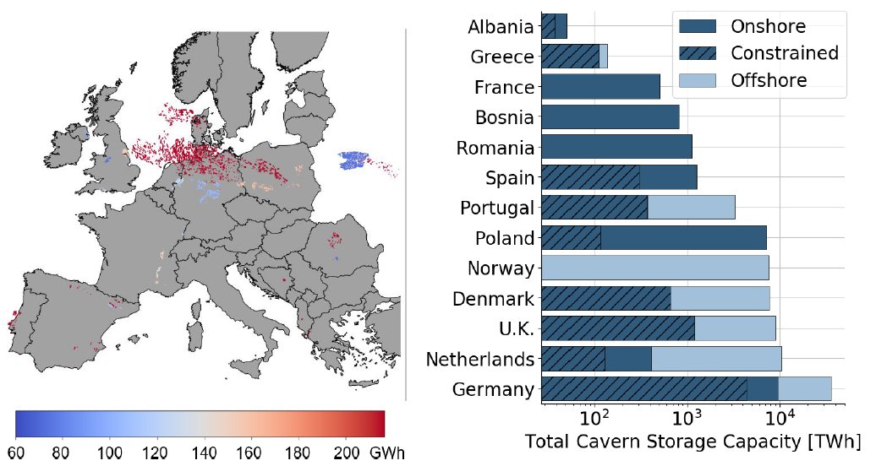
Potential hydrogen storage capacity in salt caverns in Europe
< 50 km to shore
13
Storage capacity: onshore 23,200 TWh, offshore 68,800 TWh
Source: Ad van Wijk, TUD, 2019

Slide 14
Thank you for your attention
14

Slide 15
Backup sheets
15

Slide 16
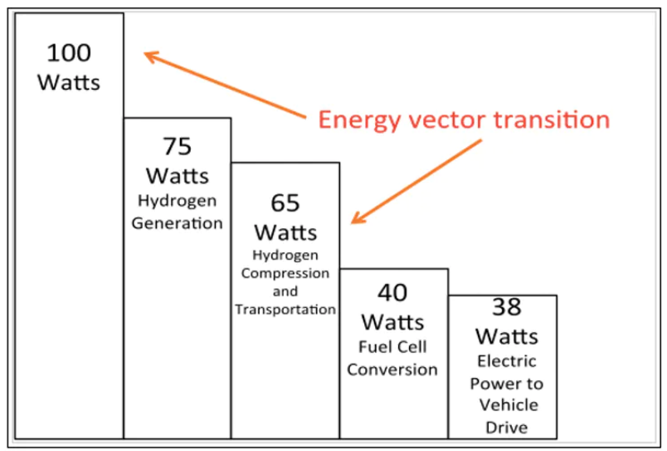
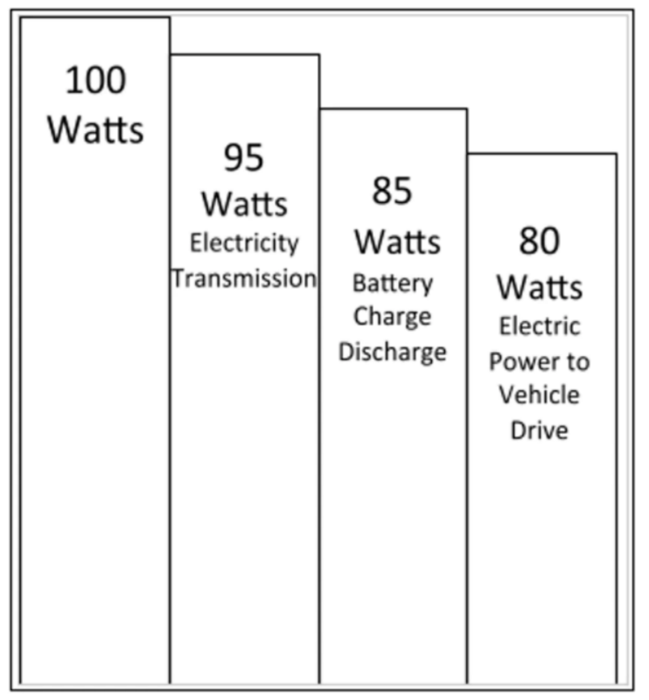
Fuel cell cars versus battery electric vehicle
Status end 2019:
BEV: 5,000,000
FCV: 7,500
In case of the fuel cell electric vehicle the overall efficiency in the power-to-vehicle-drive energy chain is roughly half the level of a battery electric vehicle.
16
Source: Energy Post 2020
https://energypost.eu/energy-conversion-for-hydrogen-cars-is-only-half-that-for-bevs/

Slide 17
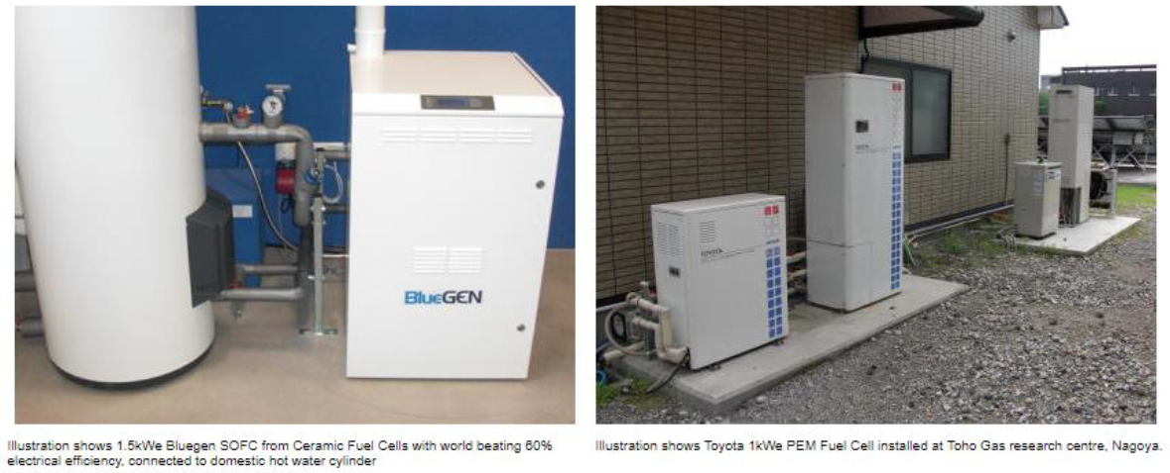
Fuel cell based micro CHP
17
Source: Albert van den Noort DNVGL 2018

Slide 18
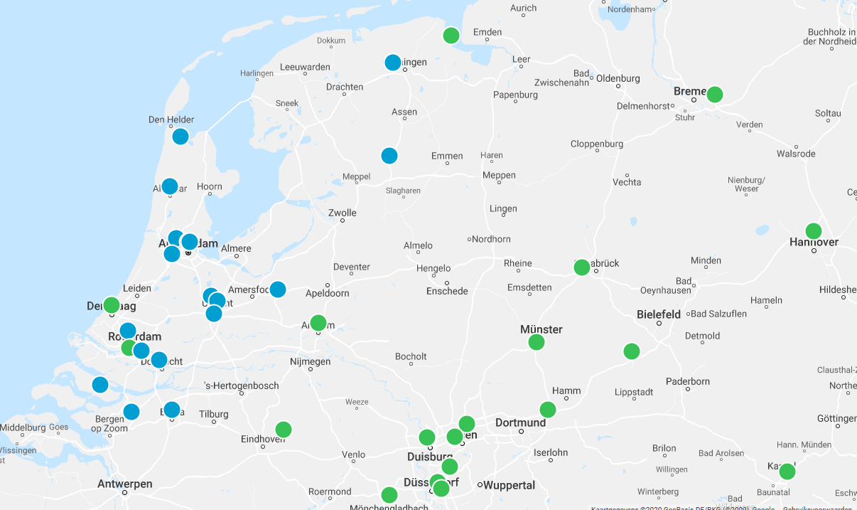
Hydrogen tanking stations NL
18
Source: Opwegmetwaterstof 2020
https://opwegmetwaterstof.nl/tanklocaties/

Slide 19
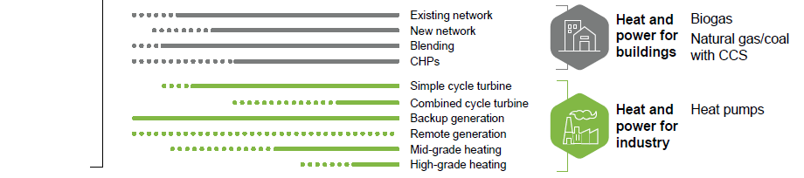
Cost competitiveness trajectories of hydrogen applications
Source: Hydrogen Council,
Path-to-Hydrogen-Competitiveness
_Full-Study-1 2019
https://hydrogencouncil.com/en/path-to-hydrogen-competitiveness-a-cost-perspective/
19

Slide 20
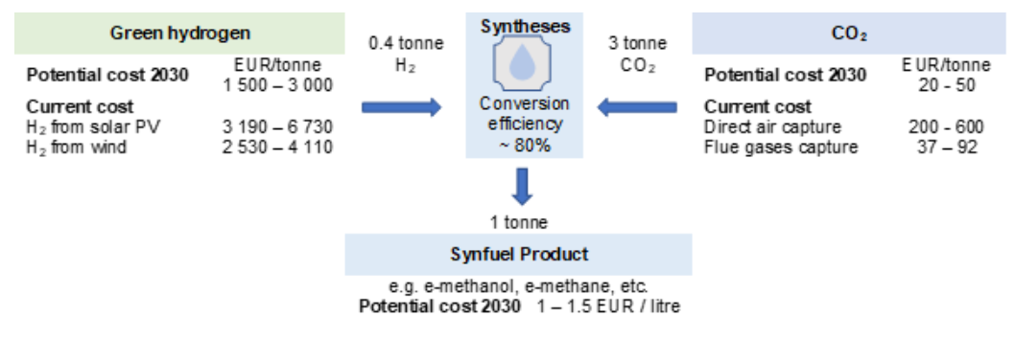
Economics of synfuel production 2030 for aviation and shipping
20
Source: IIRENA nov 2019

Slide 21
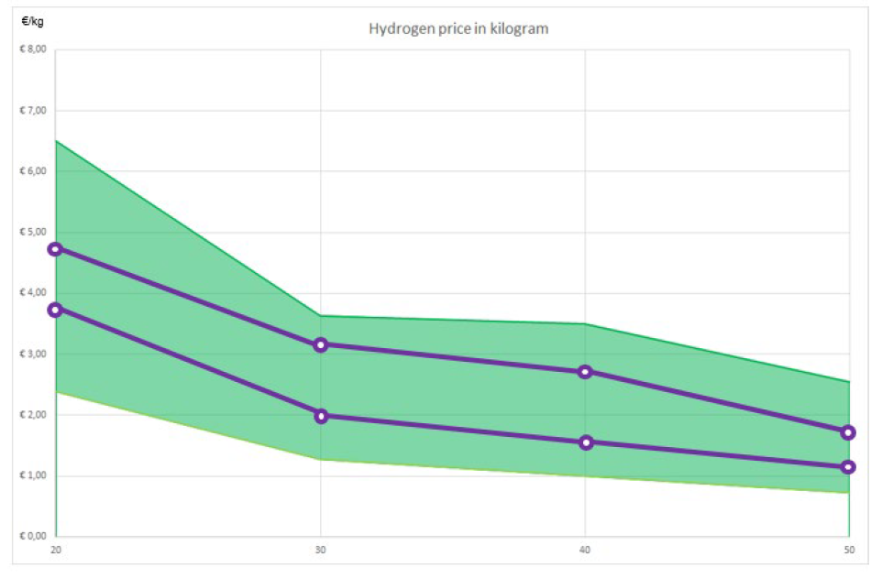
Green hydrogen production costs development 2020-2050
21
Source: TUD van As & Hellinga, 2019

