Slide 1
Long-term potential of hydrogen, expected developments
Theo Fens
Delft University of Technology
IDIC/EDI online seminar hydrogen, September 2020

Slide 2
Green hydrogen, the financials of PEM technology
 | Investment cost [€/kW] | Efficiency | Electricity Price Offshore Wind [€/MWh] | Hydrogen Price [€/kg]
Till 2020 | 600-900 | 72-75% | 40-50 | 3-4
2020-2025 | 300-600 | 75-78% | 30-40 | 2-3
2025-2030 | 250-400 | 78-80% | 25-35 | 1.5-2.5
After 2030 | <250 | >80% | 20-30 | 1-1.5
2
In 2025-2030 price parity green hydrogen with grey/blue hydrogen.
Source: TUD Ad van Wijk, 2019
http://profadvanwijk.com/

Slide 3
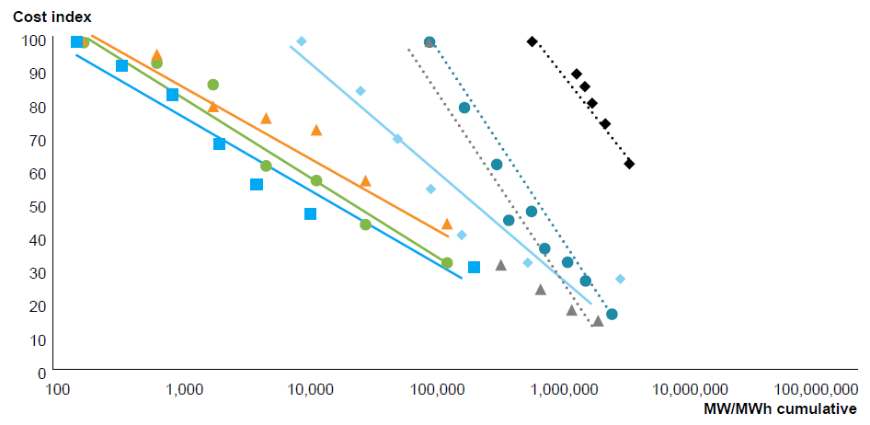


Learning rates for hydrogen generation and applications
Installed base: assuming 50/50 split of electrolysers volume with 50-75% utilisation; assuming 115 kW for PV, 250 kW for buses and 300 kW for trucks; LCOE used for solar cost; batteries in MWh.
Capex development of selected technologies over total cumulative production, indexed to 2020 values (2010 for comparative technologies).
Source: Hydrogen Council,
Path-to-Hydrogen-Competitiveness
_Full-Study-1 2019
https://hydrogencouncil.com/en/path-to-hydrogen-competitiveness-a-cost-perspective/
3

Slide 4
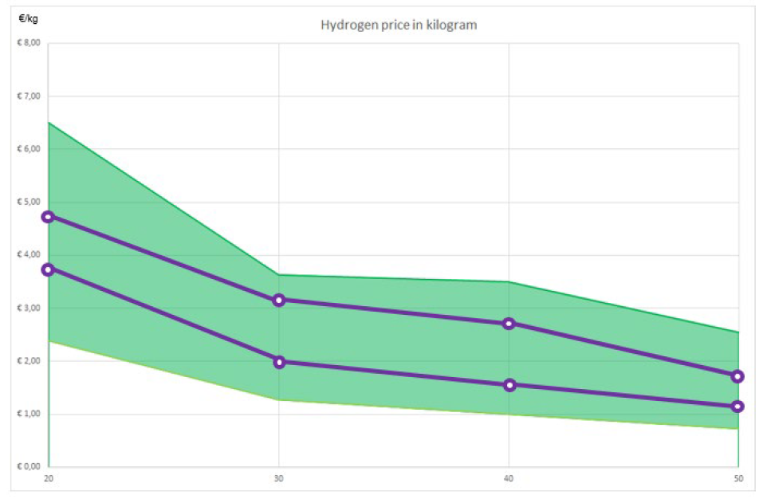
Green hydrogen production costs development 2020-2050
4
Source: TUD van As & Hellinga, 2019

Slide 5
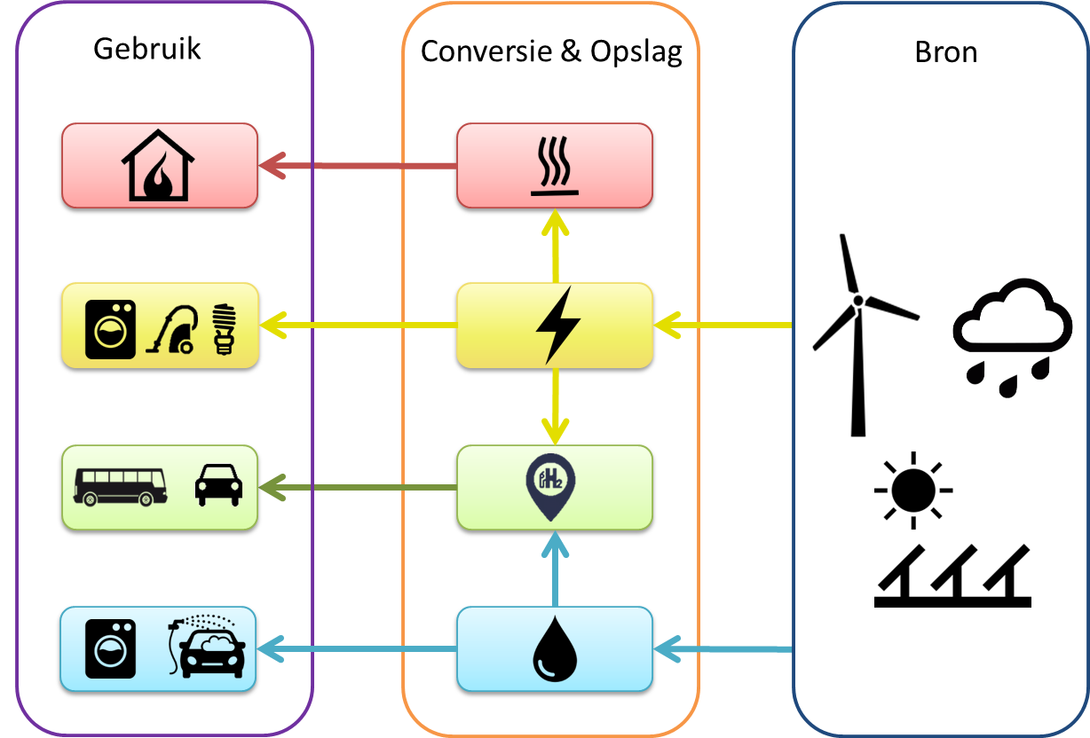
Power to X concept, integrated utility, electricity, heat and water
Usage
Conversion &
storage
Source
5
Source: Solar power to the people,2018
http://profadvanwijk.com/books/solar-power-to-the-people/

Slide 6
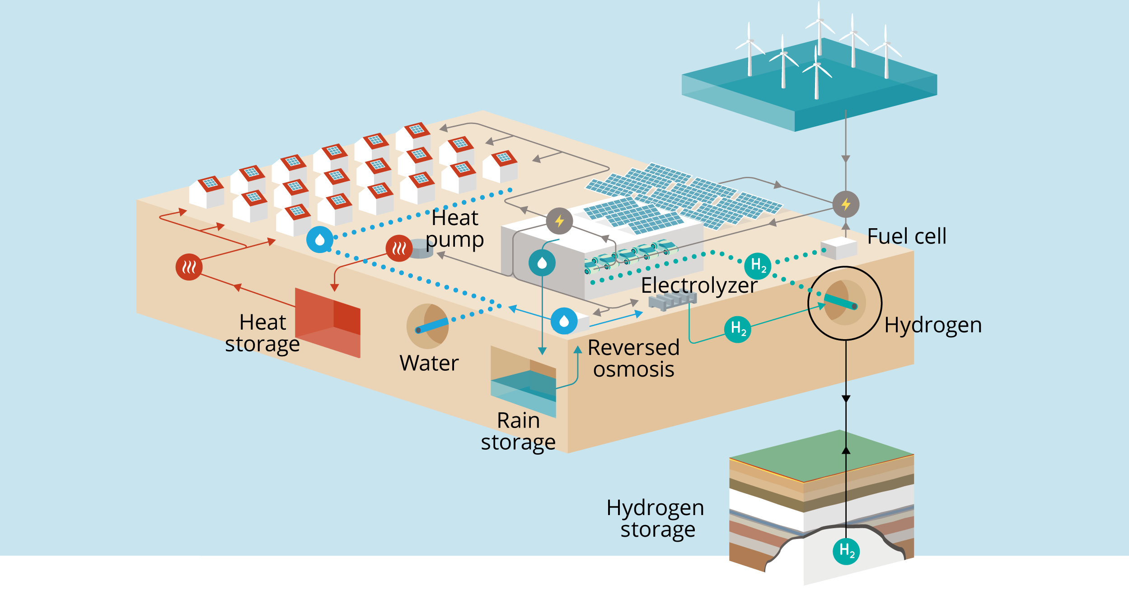
Power to X concept, system integration, major role for storage
Home batteries in houses
6
Source: Solar power to the people,2018
http://profadvanwijk.com/books/solar-power-to-the-people/

Slide 7
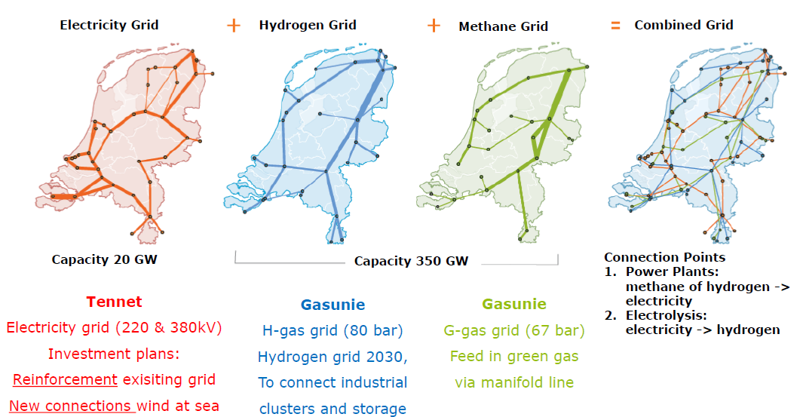
An integrated, multi energy grid in the Netherlands? Combined TSO study
7
Source: Gasunie Tennet 2020
https://www.tennet.eu/fileadmin/user_upload/Company/News/Dutch/2019/Infrastructure_Outlook_2050_appendices_190214.pdf

Slide 8
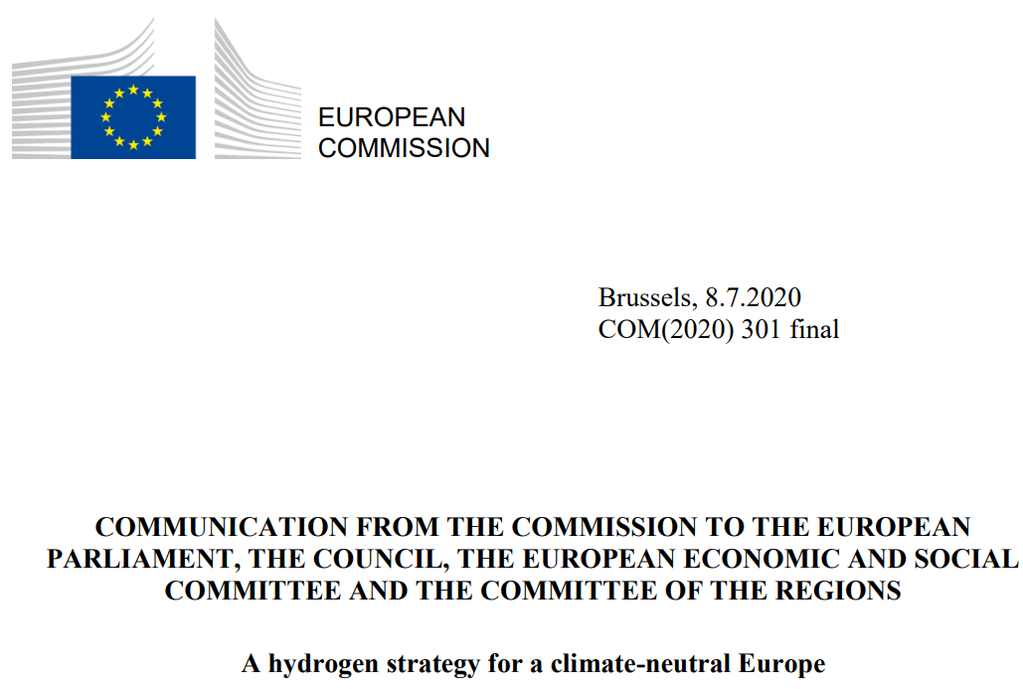
EU hydrogen strategy published July 2020
What does the roadmap for this formidable challenge look like?
8
Source: EU Hydrogen Strategy EC July 2020
https://ec.europa.eu/commission/presscorner/detail/en/FS_20_1296

Slide 9
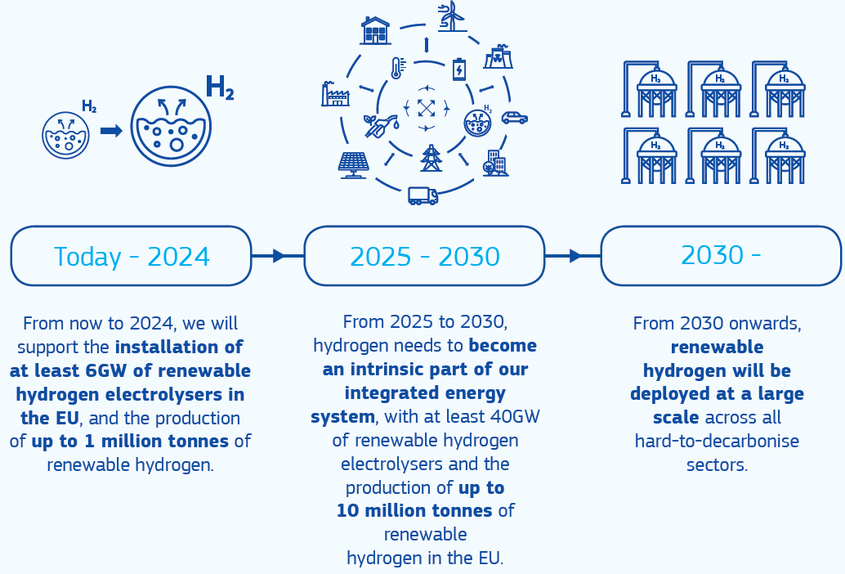
The path towards a European hydrogen eco-system step by step
How about the green power for all this green hydrogen?
9
Source: European Commission 2020
https://ec.europa.eu/energy/topics/energy-system-integration/hydrogen_en

Slide 10
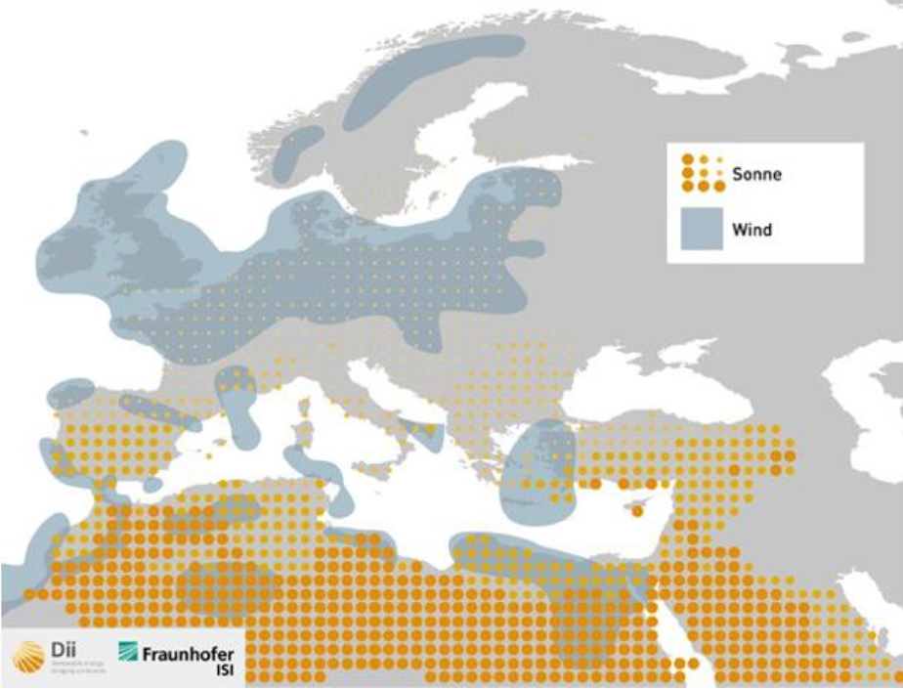
Solar irradiation and wind speed in Europe and North Africa
10
Source: TUD Ad van Wijk, 2017
http://profadvanwijk.com/

Slide 11
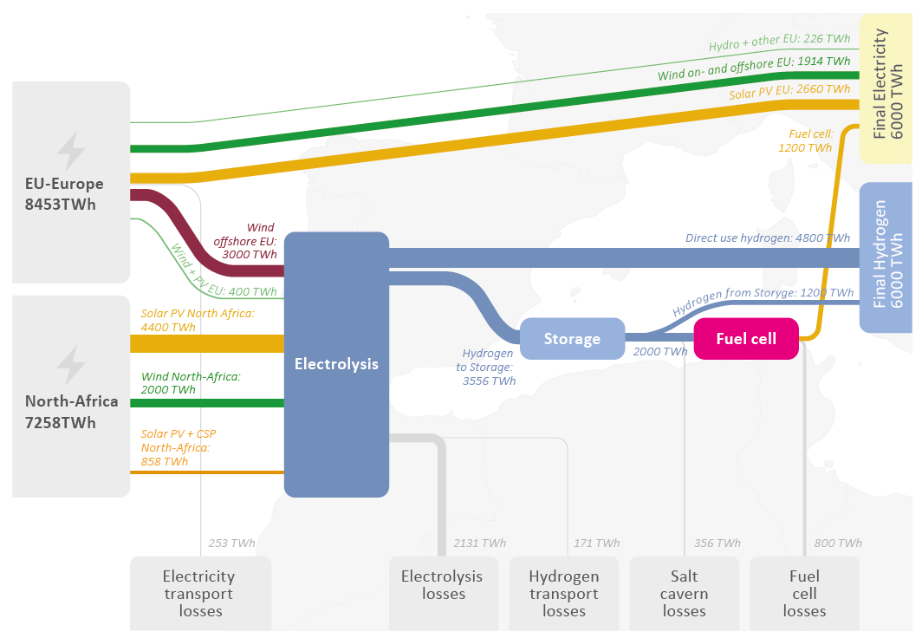
Symbiotic hydrogen project North-Africa and Europe
Energy Balance European Union 2050; primary energy production is 15,710 TWh, with
final energy consumption amounting to 12,000 TWh.
11
Source: A North Africa - Europe Hydrogen Manifesto, van Wijk et al,, 2019
https://dii-desertenergy.org/wp-content/uploads/2019/12/Dii-hydrogen-study-November-2019.pdf

Slide 12
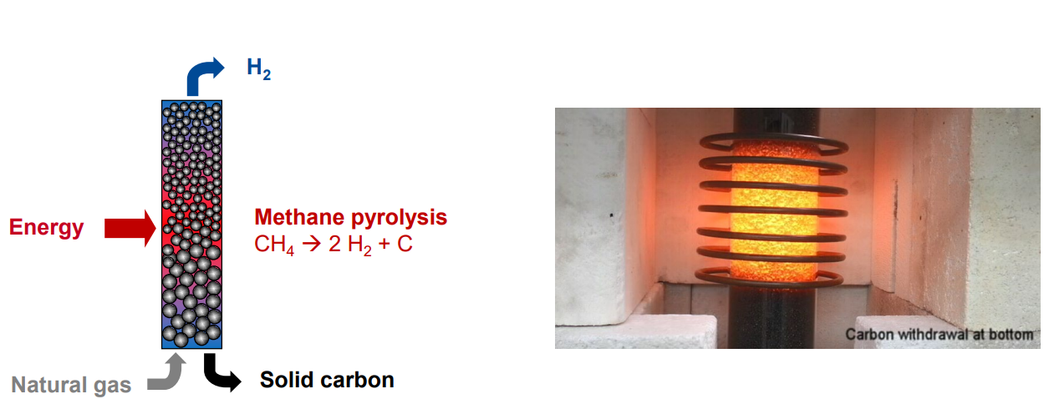
First moving carbon beds for methane pyrolysis: combined reaction and heat integration
12
Source: BASF SE November 2019
https://www.efzn.de/fileadmin/documents/Niedersaechsische_Energietage/Vortr%C3%A4ge/2019/NET2019_FF1_04_Bode_Rev1.pdf

Slide 13
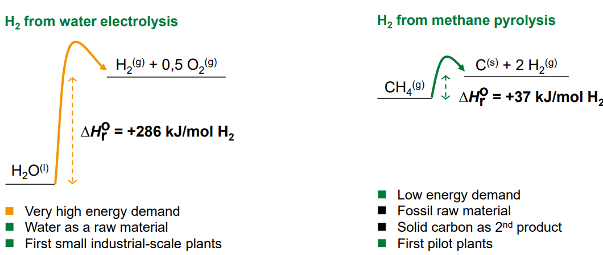
Green hydrogen: water electrolysis or methane pyrolysis?
13
Source: BASF SE November 2019
https://www.efzn.de/fileadmin/documents/Niedersaechsische_Energietage/Vortr%C3%A4ge/2019/NET2019_FF1_04_Bode_Rev1.pdf

Slide 14
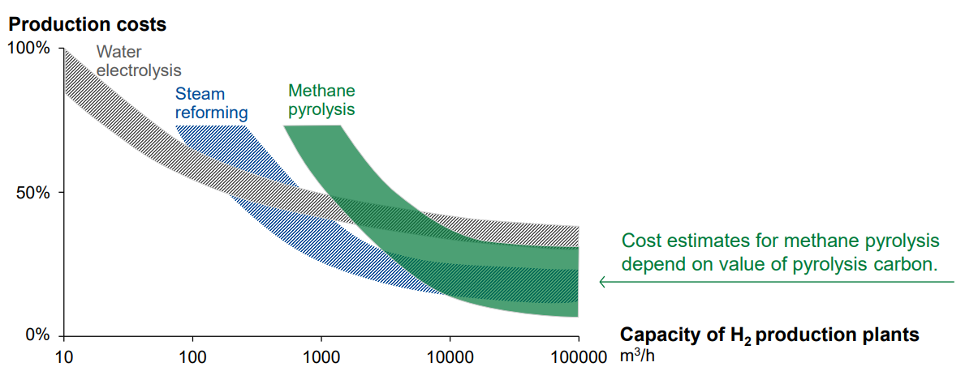
Cost competitiveness of methane pyrolysis
14
Source: BASF SE November 2019
https://www.efzn.de/fileadmin/documents/Niedersaechsische_Energietage/Vortr%C3%A4ge/2019/NET2019_FF1_04_Bode_Rev1.pdf

Slide 15
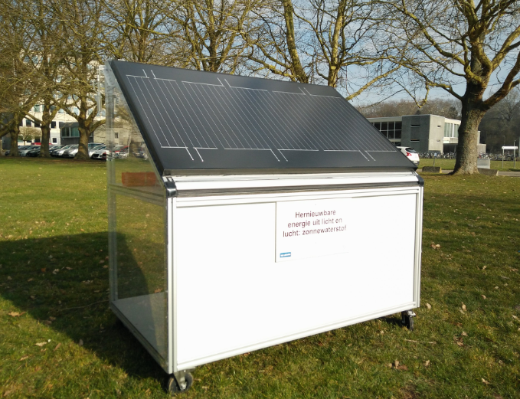
Hydrogen directly from solar panels
Bioscience engineers from KU Leuven have designed a hydrogen panel that converts 15 per cent of the sunlight straight into hydrogen gas – a world record.
15
Source: KU Leuven 2019
https://nieuws.kuleuven.be/en/content/2019/belgian-scientists-crack-the-code-for-affordable-eco-friendly-hydrogen-gas

Slide 16
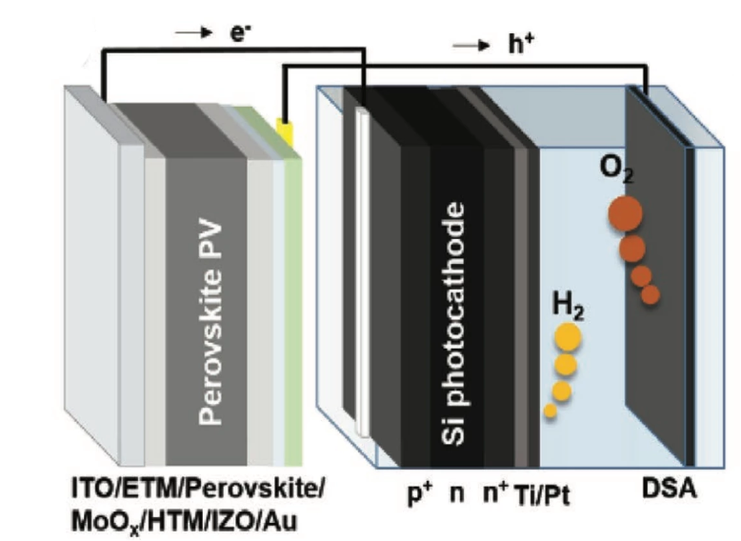

Hydrogen directly from solar panels using water splitting
Australian researchers have claimed a new world efficiency record of 17.6% for solar panels that can directly split water using sunlight. They use a photoelectrochemical (PEC) solar-to-hydrogen (STH).
The low-cost layered perovskite is combined with a convectional Si solar cell should lead to low cost hydrogen.
16
Source: Australian National University 2020
https://onlinelibrary.wiley.com/doi/epdf/10.1002/aenm.202000772

Slide 17
Thank you for your attention
17

Slide 18
Backup sheets
18

Slide 19
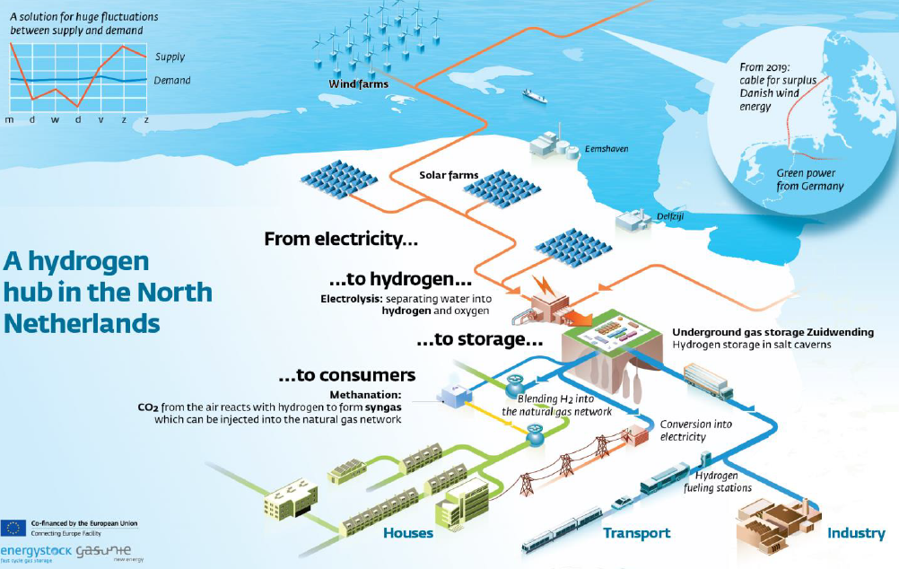
Northern part Netherlands, a hydrogen hub
Transition from a natural gas hub towards a hydrogen hub. Utilisation of the current infrastructure including salt cavern storage.
19
Source: New Energy Coalition 2019

Slide 20
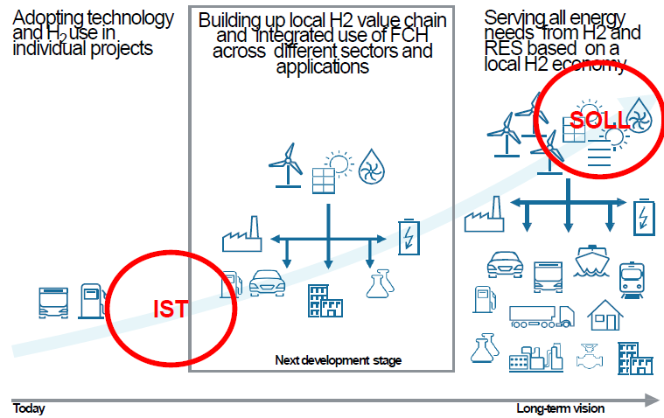
Northern part Netherlands, a stepwise development plan
By linking individual projects and developing local H₂ infrastructure, establishing H₂ Valleys represents the next development stage towards a local H₂ economy in the long term
H₂ Valleys should establish local H 2 nuclei or from which further roll out and uptake of local H₂ use can be started
Implementing H₂ Valleys should be part of a clear local strategy to start a long-term green energy transition and be backed up by respective political commitment
20
Source: New Energy Coalition 2019

