Slide 1
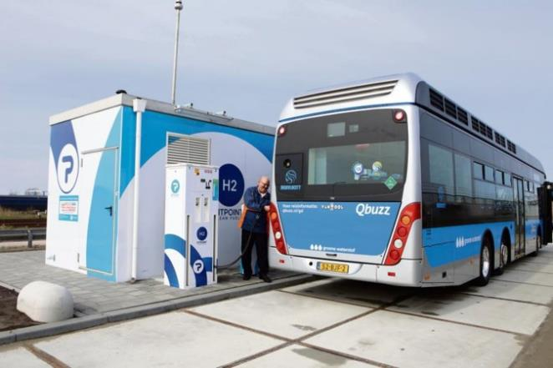
Hydrogen in the Netherlands: Principles, Policy, Plans Projects, Partnerships
Jörg Gigler
September 2, 2020
Interactive Masterclass in Hydrogen

Slide 2
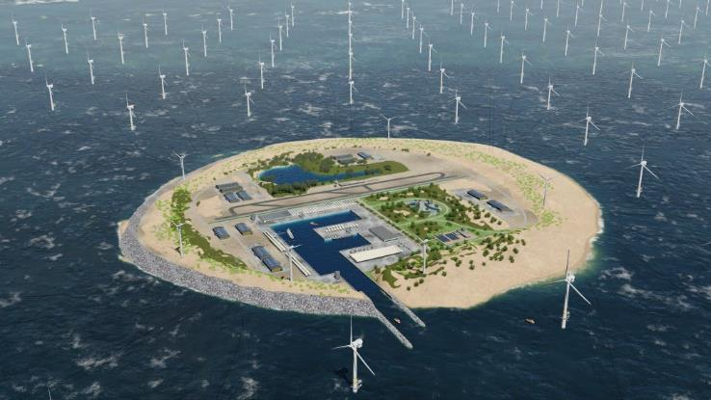
Contents
Principles: contribution to energy transition
Policy: NLs, Europe, Innovation
Plans: overview
Projects: my favourites
Partnerships: reaching out to others

Slide 3
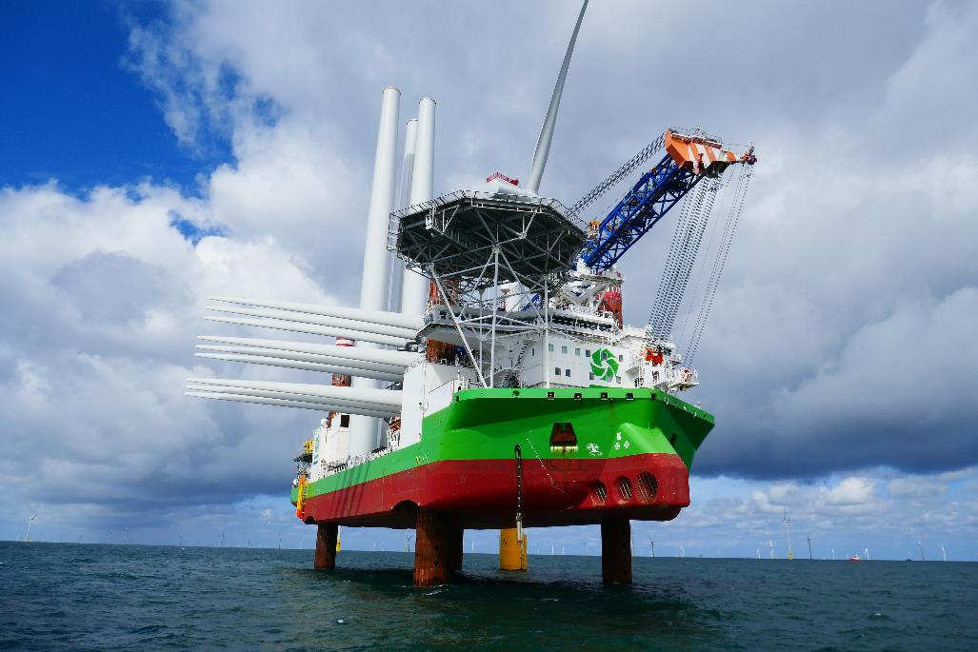
1. Principles The system it is!

Slide 4
Markets for hydrogen

Slide 5
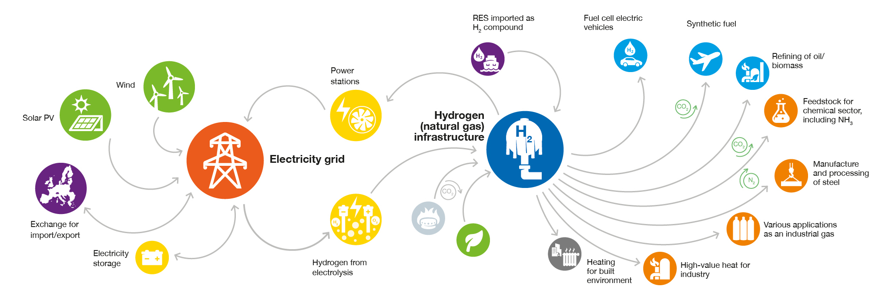
Production of hydrogen (1)

Slide 6
Production of hydrogen (2)

Slide 7
Production of hydrogen (3)

Slide 8
Production of hydrogen (4)

Slide 9
Hydrogen System!

Slide 10
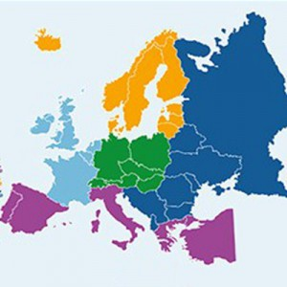
Why does the NLs have so much interest in hydrogen?
Excellent infrastructure: harbours, electricity and gas infrastructure, roads, railways, well-connected to Europe
High demand: energy intensive industry concentrated in five main industry clusters
Huge production potential for offshore wind on the Northsea
Excellent knowledge infrastructure with universities, research institutes and consultants

Slide 11
2. Policy Many developments happening simultaneously

Slide 12
Important milestones for hydrogen in The Netherlands
June 2019: Climate Agreement (-49% in 2030, carbon neutral in 2050)
January 2020: Release of Innovation Roadmap for hydrogen
(‘Hydrogen for the Energy Transition’)
March 2020: Release of Government Strategy on hydrogen

Slide 13
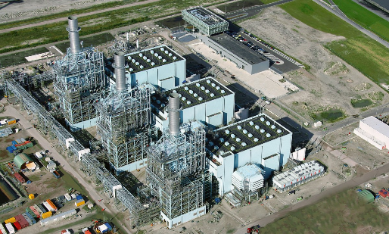
Government Strategy on Hydrogen (1) – Philosophy
Need for hydrogen for full decarbonisation
Systemic role of hydrogen
Green and blue hydrogen in many markets/applications
Opportunities for companies and innovation community
Strong need for international collaboration

Slide 14
Government Strategy on Hydrogen (2) – Policy agenda
Legislation & regulation
Infrastructure, role of network operators, certification, safety
Cost reduction & scaling up green hydrogen
Support schemes, linking hydrogen and offshore wind, blending obligation
Sustainability of end use
Ports and industry clusters, mobility, built environment, electricity sector, agriculture
Supporting and flanking policy
International strategy, regional policy, research and innovation
➔ Hydrogen Programme (to be established, ready in 2021)

Slide 15
Important milestones for hydrogen in Europe
Recently many important European announcements on hydrogen:
European Green Deal
Economic Recovery Plan (Next Generation EU)
European Hydrogen Strategy, 40+40 GW alliance

Slide 16
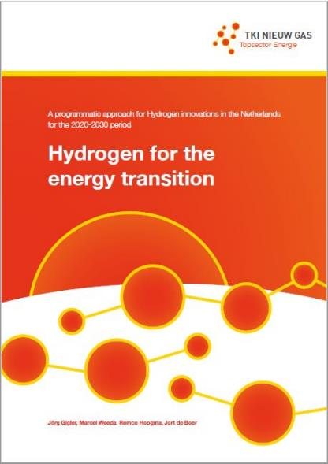
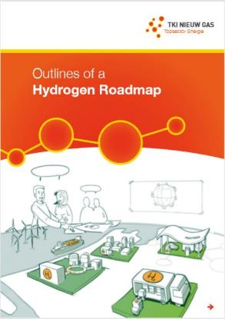
Innovation Roadmap for Hydrogen (1) – background
Outlines of a Hydrogen Roadmap: 2018
informative document on hydrogen, sketching innovation needs
Hydrogen for the Energy Transition: 2020
describes innovation strategy for the Netherlands
Process:
Timeline of about 1 year, many stakeholder discussions, ample opportunities
to provide input

Slide 17
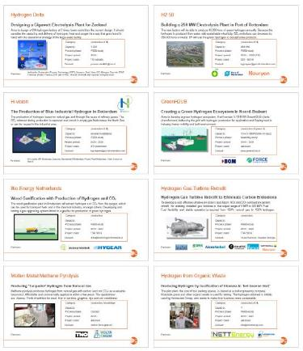
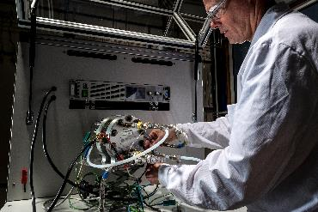
Innovation Roadmap for Hydrogen (2) – strategy
1. From vision to policy making
Demonstration in practical projects with real-world applications (pilots, demos, implementation)
3. Creating the required
conditions
Policy, legislation, infrastructure, safety, standards, quality issues
4. Research for the
longer term
(R&D > 2030)
5. Supporting and
accompanying
activities for
implementation
workforce, education, training, communication, acceptance

Slide 18
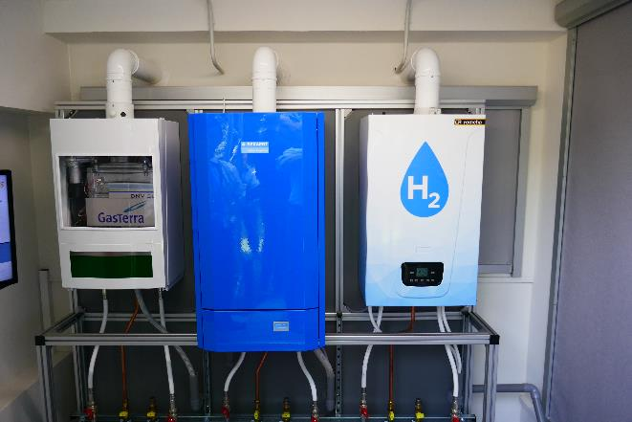
3. Plans 99 balloons…

Slide 19
Plans for projects: 99 and still counting…

Slide 20
Production I

Slide 21
Deployment: Mobility I

Slide 22
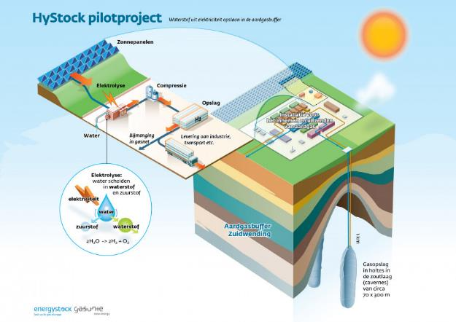
4. Projects My favorites…

Slide 23
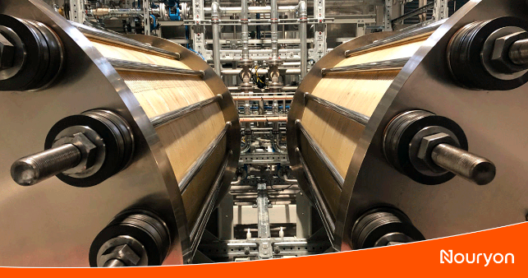
DJewels
Realisation of a 20 MW Electrolyser in Delfzijl
Operated by Nouryon and Gasunie, it will provide 3,000 tons of green hydrogen per year, reducing CO2 emissions by up to 27,000 tons per year in combined activities with BioMCN.
Category: production of hydrogen
Capacity: 20 MW > 60 MW
Process phase: FID in 2020
Project period: 2020 -
Project costs: 16 M subsidy
Contact: info@hinicio.com
Partners:

Slide 24
HEAVENN
H₂ Energy Applications in Valley Environments for Northern NL
The projects support focus on sectoral integration: the large-scale production of green hydrogen as a raw material for industry, the storage, transport and distribution of hydrogen and its application for energy supply for both industry and the built environment and in mobility.
Category: production H₂ in Energy Valley
Capacity: 30 subprojects
Process phase: execution
Project period: 2020 - 2025
Project costs: 90 M
Contact: New Energy Coalition
Partners:

Slide 25
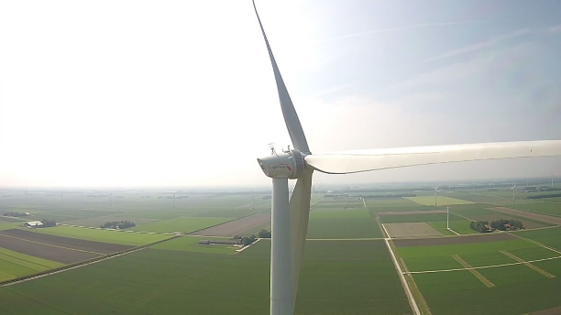
Hydrogen Mill
Building a Windmill that Produces Hydrogen
The goal is to build a 4.8 MW Lagerweij windmill and a 2 MW electrolyser to demonstrate the production of hydrogen by windmills on the ECN test location in the Wieringermeer. This is part of the DUWAAL project that focusses on the hydrogen region of north-western Netherlands.
Category: production
Capacity: 2 MW
Process phase: FEED-study
Project period: 2020 -
Project costs: unknown
Contact: jwlangeraar@hy-gro.nl
Partners:

Slide 26
PosHYdon
Hydrogen Production from North Sea Water on an Offshore Platform
A 1 MW electrolyser in a sea container on the platform, the Q13a, is very suitable for this. It is a fully electrified offshore platform. This electrification with green electricity saves 16.5 kt of CO2 per year.
Category: production
Capacity: 1 MW
Process phase: FEED-study
Project period: 2019 - 2021
Project costs: unknown
Contact: Bas Rijke / neptuneenergy.com
Partners:

Slide 27
HyStock
A 1 MW P2G Installation with Large-scale Energy Storage
Converting sustainable electricity into hydrogen for transport and industry at the site of EnergyStock storage facility. The EnergyStock facility is ideally situated for this project thanks to buffer capacity and connection with the main gas and electricity infrastructure.
Category: storage, production
Capacity: 1 MW
Process phase: commissioning
Project period: 2018 - 2020
Project costs: EU subsidy
Contact: info@energystock.com
Partners:

Slide 28
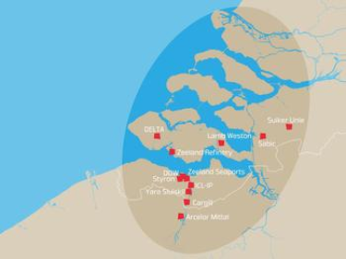
Natural Gas Pipeline to H₂
YARA Receives 4,000 tons of Green H₂ / Year from DOW Chemical
The hydrogen released by Dow crackers is used as a raw material for high-quality Yara products. This will result in an initial decrease in energy consumption of 0.15 PJ per year. In addition, it would reduce CO₂ emissions by 10,000 tons.
Category: transportation
Capacity: 4,000 tons H₂/year
Process phase: commissioning
Project period: 2017 - 2020
Project costs: unknown
Contact: evanoosten@dow.com
Partners:

Slide 29
E-THOR
Realisation of a 5 MW Electrolyser in the Botlek Area
Investigation of the technical and economic feasibility of a 5 MW electrolyser at AVR and Tronox in the Botlek. This considers the possibilities for processing CO / CO₂ from residual gas, and possibly also fluid gas, into chemical compounds such as methanol.
Category: industrial deployment of H₂
Capacity: 5 MW > 100 MW
Process phase: feasibility-study until may 2020
Project period: 2020
Project costs: unknown
Contact: rijk@deltalinqs.nl
Partners:

Slide 30
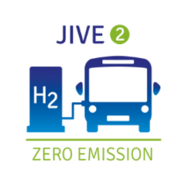
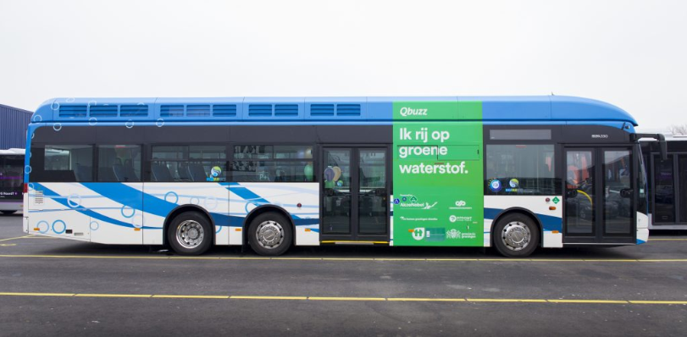
50 Fuel Cell Electric Buses
Towards Clean Public Transport with Hydrogen in the Netherlands
Demonstration of 50 hydrogen buses on Dutch public transportation. This is part of JIVE, JIVE 2 subsidies and part of a greater European project.
Category: deployment in mobility
Capacity: 50 buses
Process phase: execution
Project period: 2018 - 2020
Project costs: 25 M total EU project
Contact: stefan.neis@waterstofnet.eu
Partners:

Slide 31
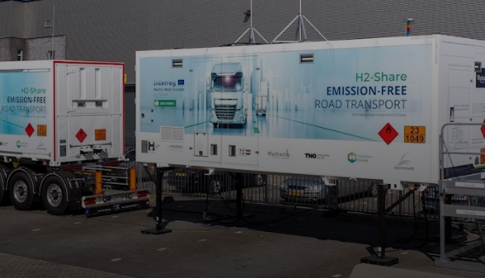
H2-SHARE
Hydrogen Solutions for Heavy-duty (27 tons) Transport in NW Europe.
For large heavy-duty vehicles which travel longer distances, electric trucks with a hydrogen fuel cell range extender are possible zero-emission solutions. In the EU, such vehicles are not yet commercially available but have enormous potential. ‘H2-Share’ aims to unlock this potential.
Category: deployment in mobility
Capacity: 1 truck, 1 mobile filling station
Process phase: commissioning
Project period: 2020 - 2023
Project costs: 1.7 M Interreg subsidy
Contact: stefan.neis@waterstofnet.eu
VDL, Wystrach GmbH, Rai Automotive NL, BREYTNER, Colruyt Group, Cure, DHL, e-mobil BW, Hydrogen Europe, Dutch Ministry of Infrastructure and Water Management, TNO, WaterstofNet. The city of Helmond and VIL
Partners:

Slide 32
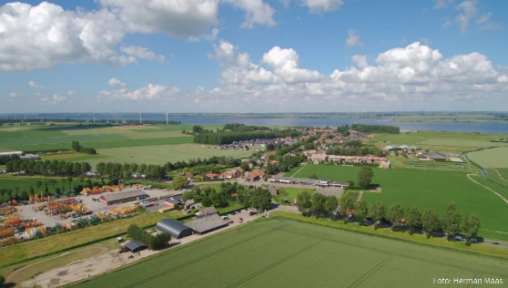
Hydrogen City
City on 't Haringvliet Switching to Green Hydrogen.
The hydrogen is to be used to heat the 600 houses in the village. The existing gas network can be used for the purpose, so no new network needs to be laid. The four "gas district stations" that still operate on natural gas are being converted and a different gas meter must be installed.
Category: deployment in built environment
Capacity: 600 residential houses
Process phase: FEED-study
Project period: 2018 - 2030
Project costs: unknown
Contact: stadaardgasvrij@gmail.com
Partners:

Slide 33
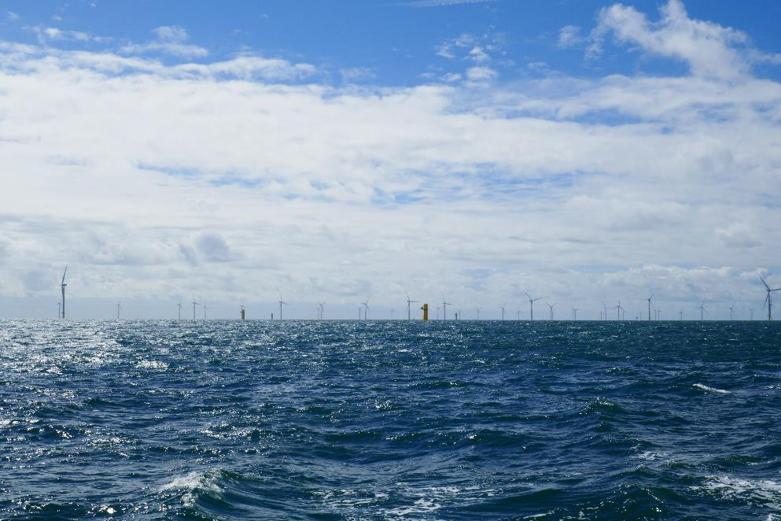
5. Partnerships European and international stakeholders forming alliances

Slide 34
International partnerships (1)
Strategy: focus is on Europe and active participation in global partnership initiatives
European Commission: at every conceivable level
Goal: to make clear to the Commission what the Netherlands regards as desirable EU hydrogen policy (standards for sustainability, safety, quality, blending of hydrogen in gas grids, flexible market regulations that provide enough flexibility for market creation, and adequate innovation support (compared to China, Japan and the US))
Pentalateral Forum (Benelux, Germany, France, Austria and Switzerland)
Goal: to develop common approaches to critical issues (standards, market incentives and market regulations ahead of the discussions in an EU context
North Sea countries
Goal: to ensure a prominent place for hydrogen on the agenda (NSWP Hub project)

Slide 35
International partnerships (2)
Bilateral cooperation with neighbouring states: Germany, Flanders/Belgium, …
IPCEI (Important Projects of Common European Interest): an European instrument for the rolling out of projects with significant value to society
Goal: a strong role for green hydrogen in Europe’s competitive position in respect of other parts of the world (focus on production and distribution of green hydrogen)
International Partnership for Hydrogen and Fuel Cells in the Economy (IPHE): international inter-governmental partnership of countries (about 20) and the EC
IEA: active participation and partnership

Slide 36
International partnerships (3)
Clean Energy Ministerial: global forum sharing best practices and promote policies and programmes that promote hydrogen (government dominated) – members account for 75% of global GHG emissions and 90% of energy investments
Mission Innovation: global initiative working to accelerate clean energy innovation (24 countries and the EC)
Trade policy: explicitly take into account the opportunities to export Dutch hydrogen knowledge and skills (US, SE Asia, Morocco, Portugal, Middle East)
And several industry-driven partnerships: Hydrogen Europe, FCH JU, …

Slide 37
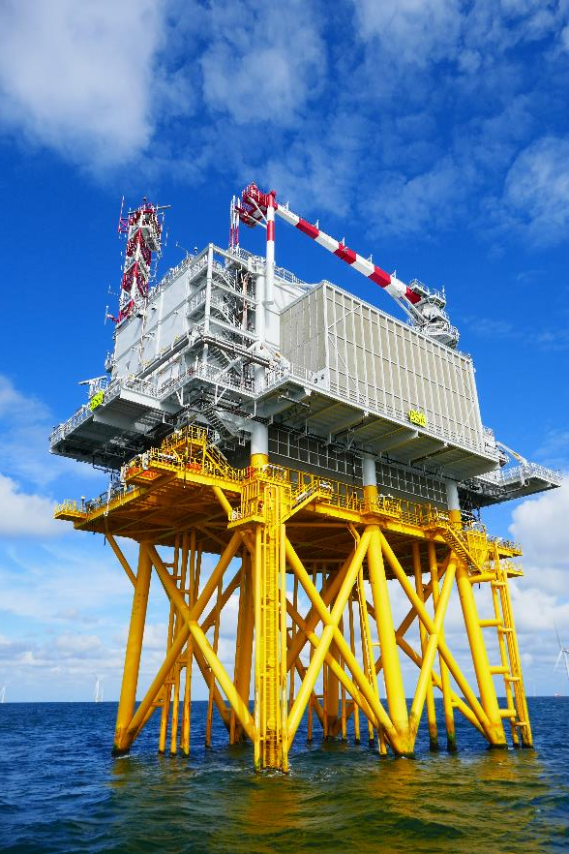
In conclusion: A lot is happening!

Slide 38
In conclusion
Dutch Government strategy is in place, supported by Europe
Innovation strategy is in place with full European Support
Many projects are being executed or are ready for demonstration and implementation – from paper to projects!
Partnerships are being developed continuously – prerequisite for a successful development of hydrogen
We have only just started and a huge joint international effort is necessary to realise the curcial role that hydrogen can play in the energy transition

Slide 39
Thank you for your attention!
Jörg Gigler (jorg@gigler.nl, +31 6 4525 1571)
Some downloads:
Government Strategy on Hydrogen
https://www.topsectorenergie.nl/sites/default/files/uploads/TKI%20Gas/nieuws/Hydrogen-Strategy-TheNetherlands.pdf
Hydrogen for the Energy Transition – Innovation strategy (2020)
https://www.topsectorenergie.nl/sites/default/files/uploads/TKI%20Gas/publicaties/7017-TSE%20Programmatische%20Aanpak%20Waterstof_EN-web.pdf
Overview of Projects
https://www.topsectorenergie.nl/sites/default/files/uploads/TKI%20Gas/publicaties/Overview%20Hydrogen%20projects%20in%20the%20Netherlands%20versie%2014mei2020.pdf
Outlines of a Hydrogen Roadmap (2018)
https://www.topsectorenergie.nl/sites/default/files/uploads/TKI%20Gas/publicaties/20180514%20Roadmap%20Hydrogen%20TKI%20Nieuw%20Gas%20May%202018.pdf

