Slide 1




Cyber Protection in ICS (Industrial Control systems)
Especially in the Hazardous Materials (HazMat) Industry
Yosi Shavit MBA, CISM
Head of ICS Cyber Security Department
Ministry of Environmental Protection
+972-58-6662242
yosish@sviva.gov.il
www.sviva.gov.il
https://www.pexels.com/

Slide 2

ABOUT ME
==========================================================
Yosi Shavit – Head of ICS Cyber Security Department
==========================================================
Bsc. Mechanical Engineering – Technion Haifa , Israel
MBA Business Management – Open University, Israel
CISM – Certified Information Security Manager – ISACA (International)
Lecturer in Academic Track for information system and Cyber at Achva College
Lecturer at major cyber conferences around the world
More than 25 years experience in Information Security and Cyber Security

Slide 3
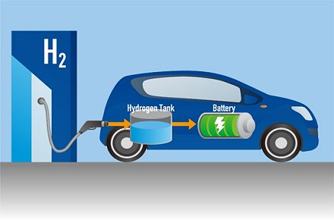
Hydrogen
Is hydrogen environmentally friendly?
Yes and maybe….. Not
Hydrogen is the lightest and most common chemical element in the universe. It is suitable for use as a fuel and has many benefits
Hydrogen generated through renewable energy is completely carbon-free
When you turn it into electricity, the only emission is water
Hydrogen is also easy to store and transport
Hydrogen allowing us to use the full potential of renewable energy sources
Hydrogen is found almost everywhere, which gives it additional value as an energy source.

Slide 4
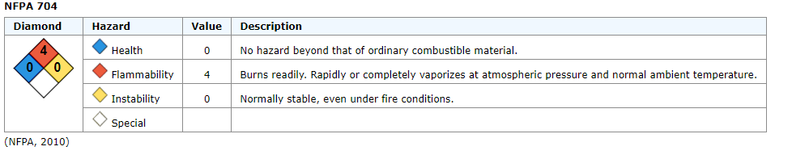
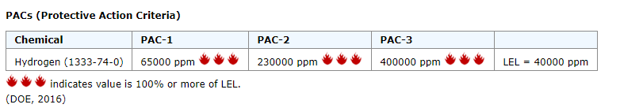
Hydrogen
Is hydrogen environmentally friendly?
Yes and maybe….. Not
Source: https://cameochemicals.noaa.gov/

Slide 5
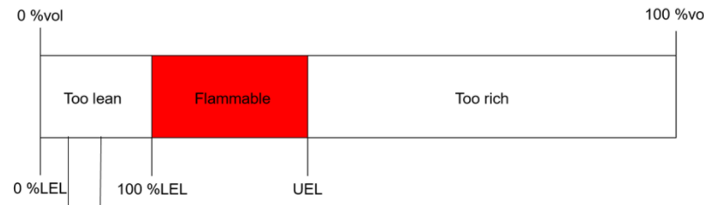
Hydrogen as a hazardous substance
What is LEL?
The Lower Explosive Limit (LEL) is the lowest concentration of a gas or vapor that will burn in air.
Hydrogen LEL = 40000 ppm
Hydrogen is an explosive / flammable substance (can explode at a minimum concentration of hydrogen gas in a homogeneous mixture with oxygen).
The reaction that occurs:
2H2(g) + O2(g) → 2H2O(l) ΔHo = - 572 kJ

Slide 6
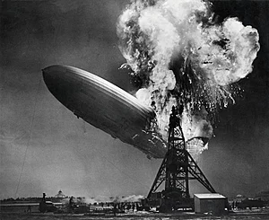
Hindenburg disaster occurred on May 6, 1937
Hydrogen + Oxygen + Spark
of electrostatic electricity
97 people on board
36 died from the incident

Slide 7
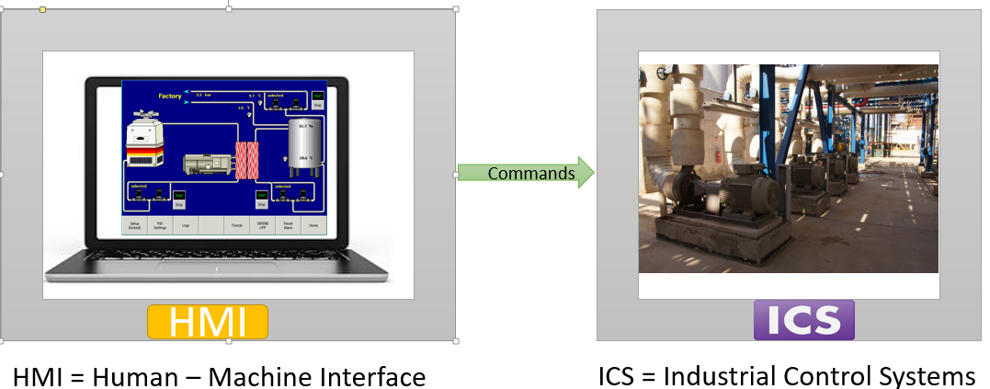
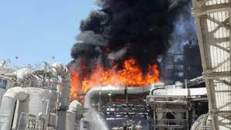
Hazardous Materials and Cyber Security
In a cyber attack, if HazMat production systems are connected to computer systems, you can do following things:
Damage to production system
Damage to materials in the factory during storage
Disruption of overall inventory management of hazardous materials
Changing the formula in a computerized process
Changing pressures, temperatures, flow rate and PH values ​​of hazardous materials
Production Floor – OT network
Can results great damage
to the environment and to public health

Slide 8
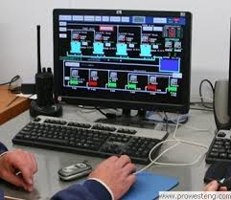
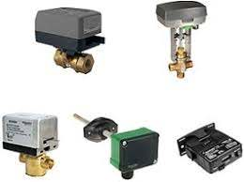
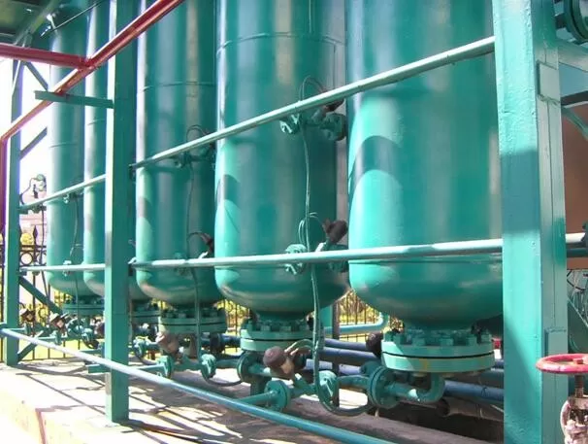

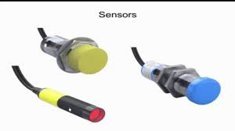

ICS – Industrial Control System
OT NETWORK
HMI Station
Field Devices (Actuators)
HazMat
PLC Controller
Sensors

Slide 9
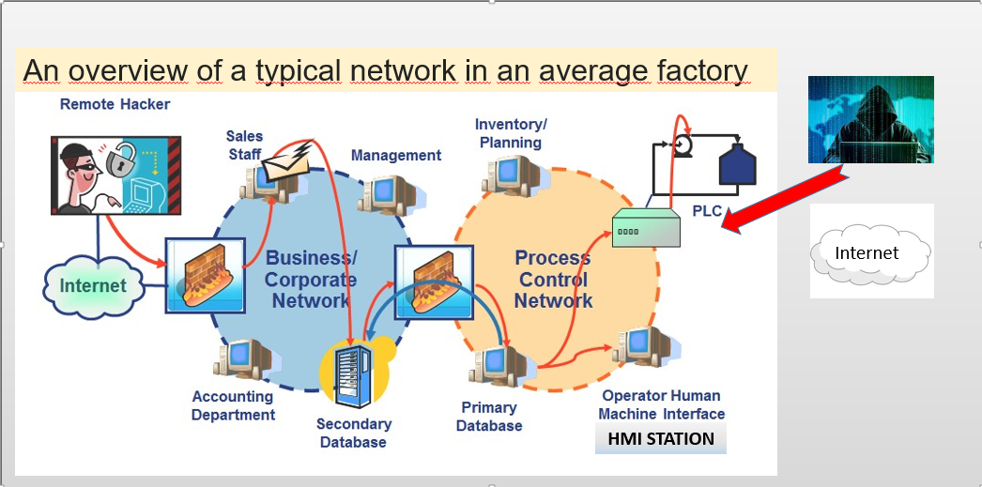
How to attack a hazardous materials production system
IT NETWORK
OT NETWORK

Slide 10

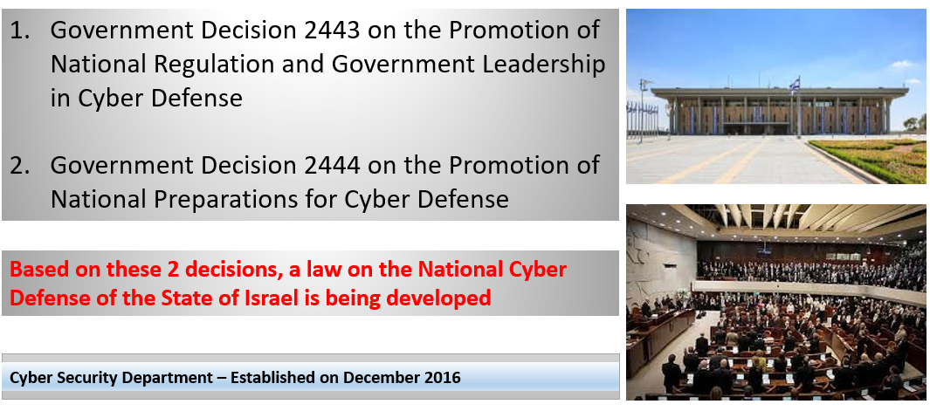

Slide 11

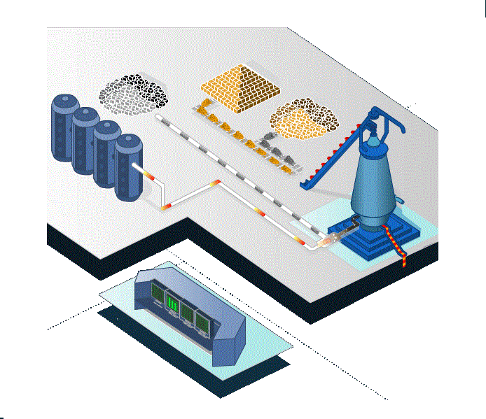


ICS Cyber Security Department Roles
Development of Methodology, Definition of
Policies and Requirements
Initiation & Implementation of Additional Actions, for Cyber Defense in the Industry
Information Technology
Monitoring Compliance of Regulatory Requirements
Operation Technology
Human Awareness & Reliability
Physical Security
Organization & Functioning of Information Exchange Between Enterprises and Organizations in the Sector

Slide 12



Our Goal
To Increase the Cyber Resilience of the Hazardous Materials Industry (Including the Hydrogen industry (
https://www.pexels.com/
https://www.pexels.com/
https://www.pexels.com/

Slide 13


Good News for 2020
2 Important News for the Israeli Hazmat Industry:
1
2
New Cyber Regulation
on Hazardous Materials Industry
New ICS Cyber Methodology
for the Hazardous Materials Industry

Slide 14
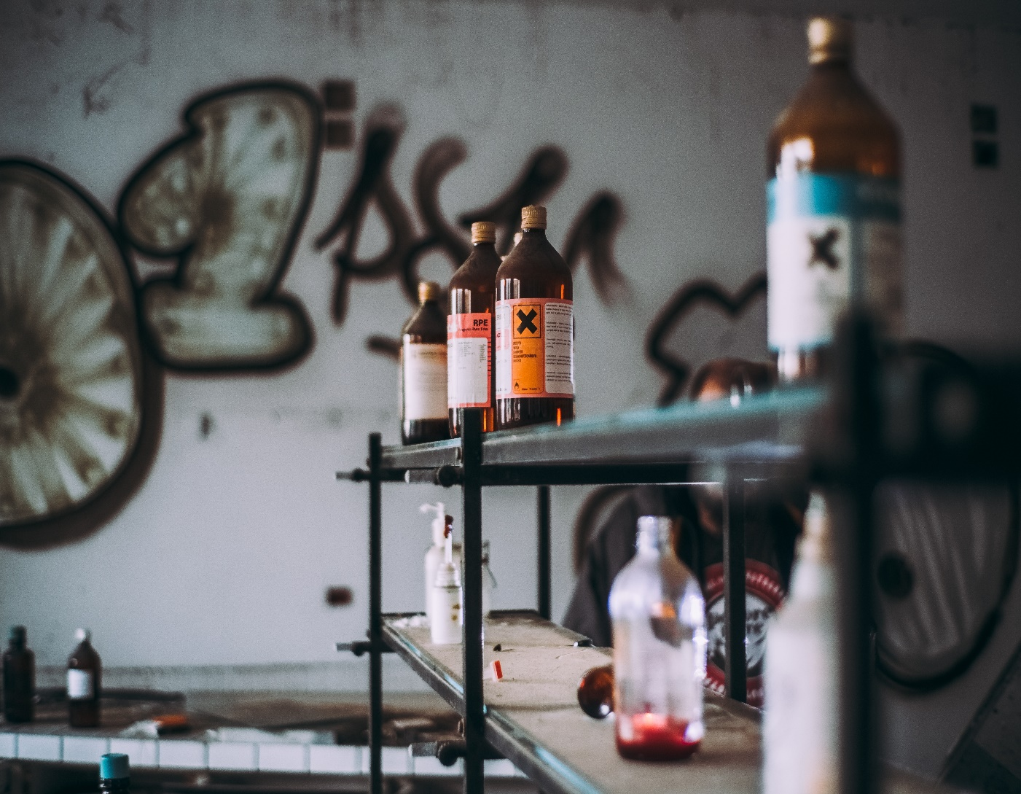
4262 Businesses Under our Regulation
In the ICS Cyber Security Department we Instruct, control and enforce all businesses which receive toxin permit from us
Hazardous Materials Industry
Water Corporations
Israel's Electric Company (Flammable Materials )
Water Treatment Plants
Sea Ports) Transportation of Hazardous Materials (
Airports
Pharmaceutical Industry
The Pesticides Industry (Fertilizers)
Hospitals)ETO to sterilize Medical Equipment )
Swimming Pools (Hypochlorite and Salt Acid to purify the water causes reaction in contact with each other)
Wineries (Sulfur Dioxide for the preservation of the wine, becomes Sulfuric acid in contact with air)
Trucks carrying hazardous materials
Hydrogen Production Industry
https://www.pexels.com/

Slide 15
Toxin Permit
The regulation is imposed by a mechanism called a Toxin Permit
Group | Renewal Period | Amount of businesses
A | 1 Year | 382
B | 2 Years | 555
C | 3 Years | 3325
The group is determined according to 2 criterias :
Quantity of hazardous materials
Proximity to a public area
Conditions of Maintenance, Storage and Transport of Hazardous Materials
+ Gradually Additional Conditions for Cyber Protection
Based on the National Hazardous Materials law Since 1993

Slide 16
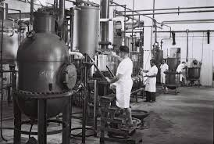
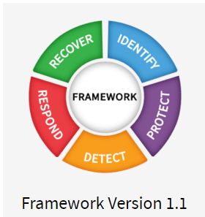
New Methodology - Cyber ​​Guide
Version 1.3 July 2020
NIST CSF
1.1
In-depth field work in collaboration
with several factories

Slide 17
New Methodology - Cyber ​​Guide
Risk Assessment in the Hazardous Materials Industry
Appendices:
Plant Statement on Risk Assesment Execution
      Plant Declaration on Implementation of Controls
      Who is allowed to do risk assessment in a plant
      Template for a Cyber Event Report
The Stages needed for Work plan
Timetables for regulatory implementation
List of recommended cyber controls
https://www.gov.il/he/departments/publications/reports/cyber_industry_toxins_permit

Slide 18
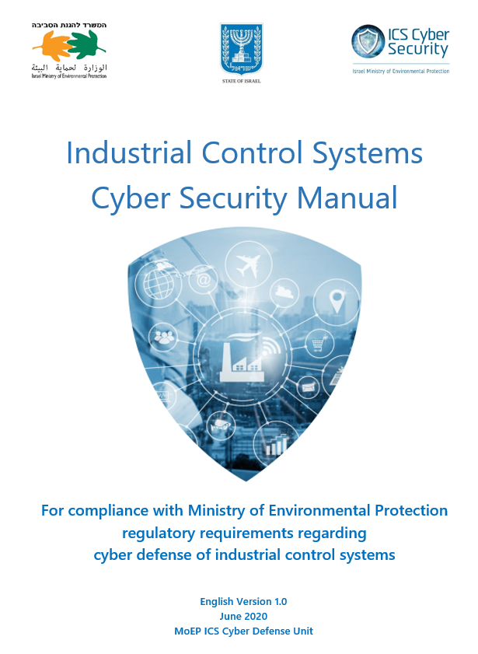
New Methodology - Cyber ​​Guide
At the request of the OECD organization
this guide will be translated into English
Draft

Slide 19
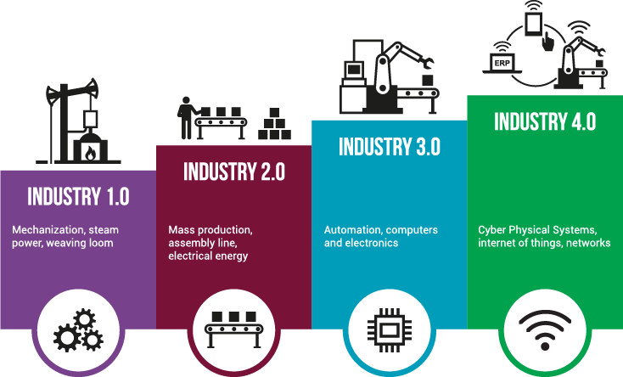
Cyber ​Risks in HazMat - Background
  Hazardous Material Industry were established in the State of Israel decades ago.
  The main scope was manufacturing , nobody thought of cyber at that time :
  The systems are designed for production only
  Production systems were connected to the computer by serial cables
  Factories were located far from population areas – but over the years
  populated areas came close
  Life was better in cyber aspect but much less efficient
IIOT DEVICES
OPEN TO INTERNET
Until 2 significant revolutions have come:
Industry 3 & Industry 4
  http://brunothalmann.com/industry-4-0/

Slide 20

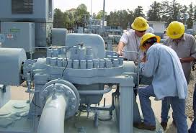
More Important recent events
March 2020 - COVID 19
New Threats: remote control of employees from home to the plant, conference calls reveal the plant to further threats
https://zencity.io/
May 2020 – Massive Attack on industrial control systems in Israel water supply facilities including chlorine facilities
https://www.pexels.com/
https://www.pexels.com/

Slide 21

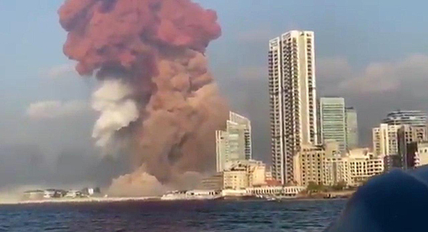
July 2020 - A number of incidents related to Hazardous Materials in Iran (some fires in refineries, power plants and A plant containing chlorine (in addition to cyberattack on Iranian port facility Bandar Abas.
https://securityaffairs.co/wordpress/35419/hacking/iran-cyber-capabilities.html
August 2020 - Beirut explosion of Ammonium Nitrate blast - everything was destroyed within a radius of 2 km , damage was found within a radius of 10 km
https://www.calcalist.co.il/world/articles/0,7340,L-3843530,00.html

Slide 22
Risk Assessment and compiling a Compliance Plan
Mapping of Dangerous Processes and Risks
Cyber Risk Assessment
Gap Analysis
Build a Work Plan
Work Program Execution
Maintenance & Monitoring
Classification of ICS systems
Work Planning
Second Stage
First Stage
24 Months
12 Months

Slide 23


Appointing a Cyber Security Officer within 60 days
2 Preliminary Steps
https://www.pexels.com/
Publishing a Cyber Security Policy
for the plant
https://www.pexels.com/
Notes:
Appointing a Cyber Security Officer
The recipient of the hazmat permit, shall, within 60 days of receipt of these requirements, appoint a person on their behalf, who shall be entrusted with the execution and application of these requirements.
The hazmat permit holder and the selected officer shall fill out and sign the form in Appendix C-1 ("Cyber Security Officer Appointment"), and send it to the MoEP supervisor who oversees that organization.
The hazmat permit holder can decide whether the Cyber Security Officer shall be dedicated to this role or keep other duties as well.
The Cyber Security Officer shall act as liaison to the MoEP Cyber Defense Unit, in all matters related to cyber defense requirements listed below.
The hazmat permit holder shall appoint an acting Cyber Security Officer during any absence of the permanent Cyber Security Officer
Publishing a Cyber Security Policy for the organization
The organization's management shall formulate and ratify a formal cyber defense policy. This policy will detail the commitment of the organization's management to the process of increasing cyber resilience across the organization, and list the first steps the organization will take, such as allocating resources to the subject, nominating a dedicated Steering Committee, deciding to adhere to additional standards and regulations (ISO 27001, GDPR etc.), and any other optional relevant decisions.
The organization shall present the policy document to their supervisor at the MoEP as required.

Slide 24

Mapping of Dangerous Processes and Risks
Step1
Mapping and listing the Hazardous Computerized Processes
List hazmats that meet
Seveso III criteria
List processes linked to usage and safety of the hazmats
Choose computer-controlled and automated processes
Notes:
Listing the relevant hazmats and their usage
The organization shall review the hazardous materials listed in its most recent permit, and list the usage of those materials with amounts reaching or surpassing
Seveso III Lower Tier/Upper Tier thresholds (on their own or as part of a group of materials of the same hazard category), using the form in Appendix C-5 ("Preliminary Hazmat Mapping").
Mapping and listing the Hazardous Computerized Processes (HCP)
Describe processes and map out materials that are being used, manipulated, stored, or conveyed using any ICS elements. This document should include materials that are protected with automated safety measures, and describe the processes involving both the materials and ICS elements.
Note, that an HCP can be a process that, on its own, does not involve hazardous materials, but could nevertheless leave a factory and the environment vulnerable to hazardous materials if its ICS elements fail or are compromised, creating a hazard such as a fire, explosion, flood, piercing of storage tanks, etc.

Slide 25
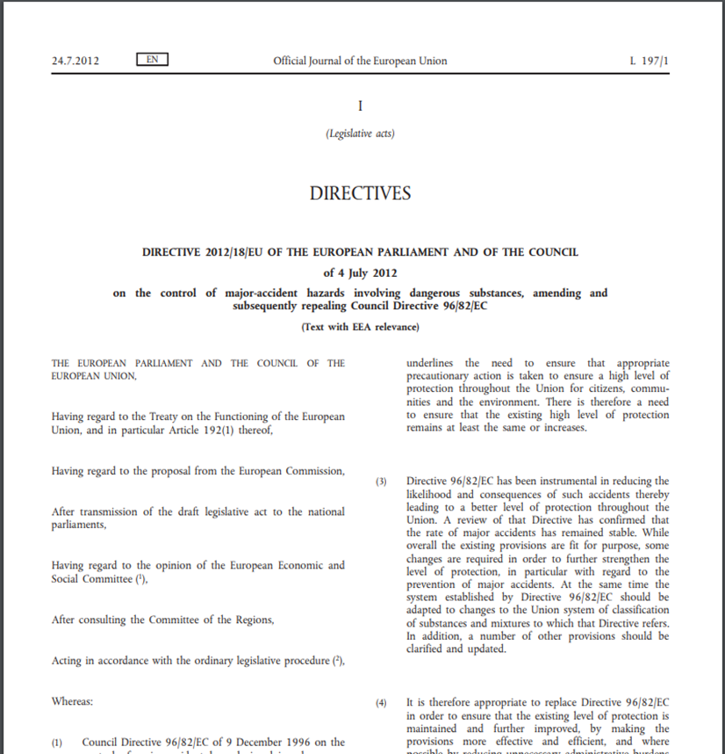
SEVESO III Directive
The Ministry of Environmental Protection has adopted the SEVESO III Directive

Slide 26
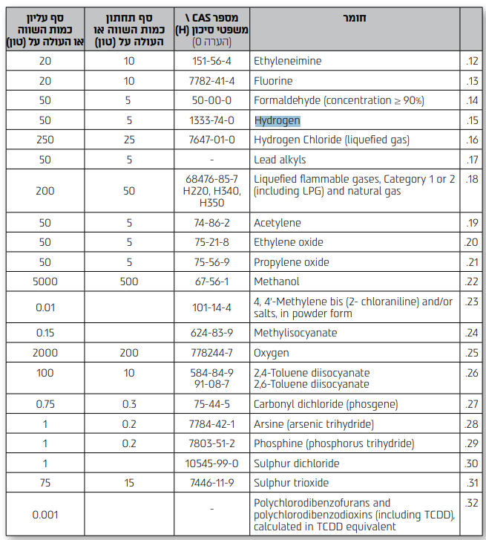
Table of Hazardous Substances according to European Directive
SEVESO III Directive
Material | Cas # | Seveso Lower Tier (Tons) | Seveso Upper Tier (Tons)
Seveso Lower Tier
Seveso Upper Tier
Seveso Upper Tier | Seveso Lower Tier | Material
> 5o Tons | > 5 Tons | Hydrogen

Slide 27
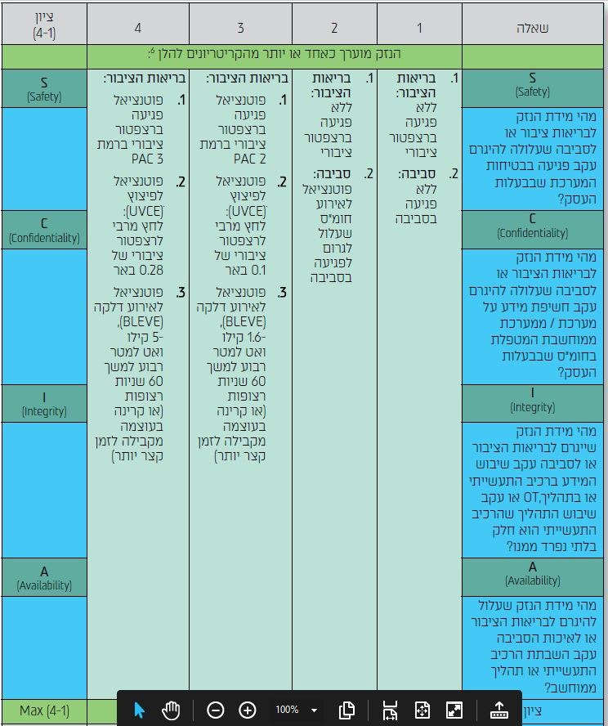
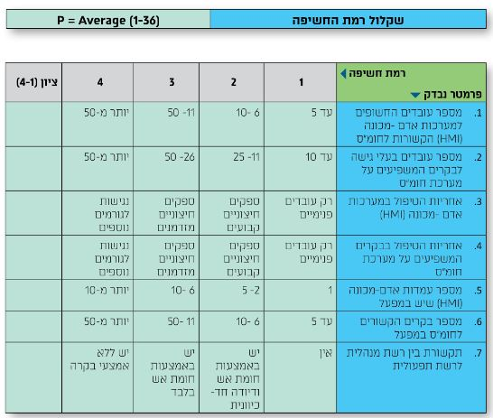
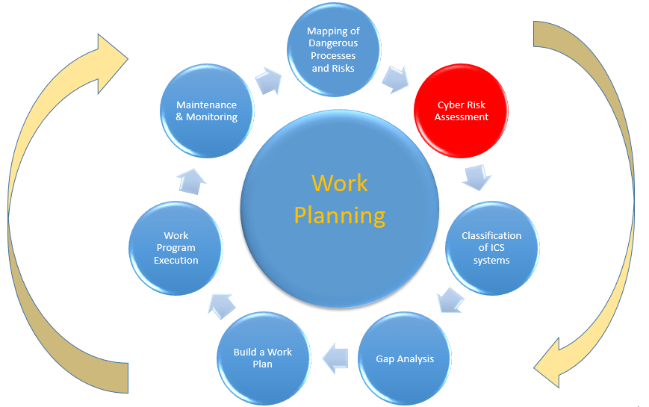
Risk Assessment
Step 2
Risk assessing each system
I
IMPACT
INCD (Israel National Cyber Directorate)
Risk = P + 3*I
P
PROBABILITY
Notes:
Risk assessing each HCP
For each of the HCPs identified, the organization shall perform the risk assessment process detailed below in section 5 - Risk Assessment and Scoring.
The outcome of this assessment is a Risk Score for that process. The Risk Score determines that HCP's Risk Level (1 = Low Risk; 4 = Very High Risk).
The Risk Level determines the Required Controls for that process, and affects all ICS systems/elements taking part in the process.
For ICS systems/elements that govern or are used in several HCPs, the highest Risk Level process determines the controls to be implemented.
The sum of all the controls required for all the HCPs is the list of Required Controls the organization needs to have in place in order to adhere to these regulations.
On completion, the hazmat permit owner shall fill out and sign the form in Appendix C-3 ("Declaration of Computerized Systems Controlling Hazmats").
Organizations should consider hiring specialists for this stage, or have their own operational/environmental personnel trained and certified for this stage.
For basic guidelines on required knowledge and experience, see Appendix C-6 ("Qualification requirements for consultants performing Risk Assessment").
Required Delivery: A completed and signed C-3 form, with an attached list of mapped out hazardous processes and systems

Slide 28
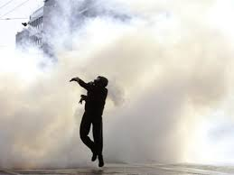
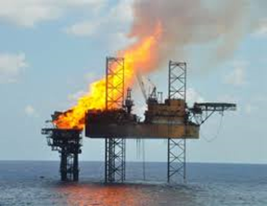
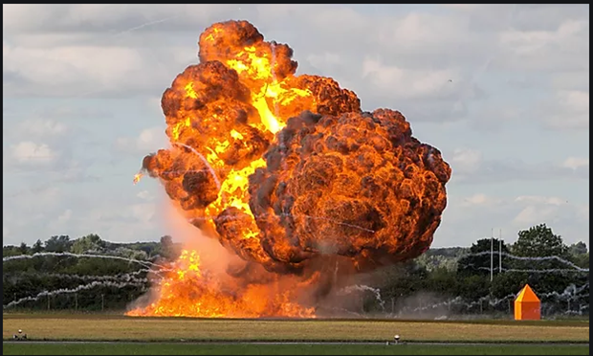
Calculating Impact of Cyber Attack (I)
A cyber attack can have the following scenarios:
1. Dissipation of dangerous toxins - the measurement
is made by concentrating poison in the air (PPM units)
2. Flammable gas cloud (UVCE) - the measurement is
made in units of pressure (BAR)
3. A Fire Ball (BLEVE) which radiatinig heat - the measurement
is made in units of kilowatts per square meter (KW/m²)

Slide 29
Calculating Impact of Cyber Attack (I)
Impact Value | Most severe impact analyzed
1 Very Low | No health hazard to surrounding Public Receptor (calculated values do not amount to PAC-1) AND NO environmental damage.
2 Low | Maximum health hazard to surrounding Public Receptor is within the definition of PAC-1, AND/OR ANY environmental damage.
3 Medium | Maximum health hazard to surrounding Public Receptor is within the definition of PAC-2, AND/OR Potential for a UVCE event, reaching or exceeding overpressure of 0.1 bar on a Public Receptor, AND/OR Potential for a BLEVE or fire event, reaching or exceeding a heat flux of 1.6 kW/m² for a duration of 60 seconds, or the equivalent energy for a shorter duration, on a Public Receptor.
4 High | Maximum health hazard to surrounding Public Receptor is within the definition of PAC-3, AND/OR Potential for a UVCE event, causing overpressure reaching or exceeding 0.28 bar on a Public Receptor, AND/OR Potential for a BLEVE or fire event, causing a heat flux reaching or exceeding 5 kW/m² for a duration of 60 seconds, or the equivalent energy for a shorter duration on a Public Receptor.
I
Impact

Slide 30
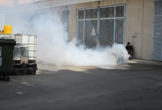
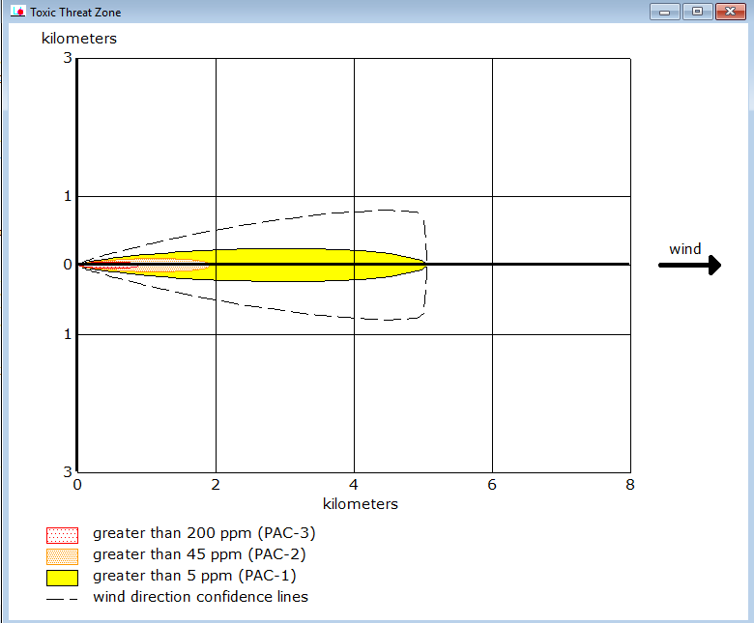
PAC – Protection Action Criteria
Methodology for Evaluation of Potential Hazards to Human Life or Health
PAC1 - Potential for dispersal of hazardous substances, accompanied by a reversible public health impact
PAC2 - Potential for dispersal of hazardous substances, accompanied by irreversible damage to public health
PAC3 - Potential for dispersal of hazardous substances, with fatal impact on public health
*It's about an hour's exposure
https://www.weizmann.ac.il/safety/he/%D7%AA%D7%A8%D7%92%D7%99%D7%9C-%D7%97%D7%95%D7%9E%D7%A8%D7%99%D7%9D-%D7%9E%D7%A1%D7%95%D7%9B%D7%A0%D7%99%D7%9D-1962014-hazardous-materials-drill

Slide 31
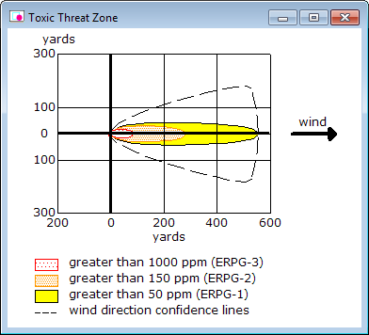
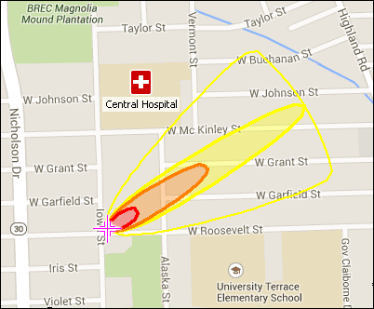
PAC calculation software
ALOHA 5.4.7
MARPLOT 5.1.1
Export
Recommended Separation Distances
INPUT:
Atmospheric conditions: wind direction and intensity
Location: precise details of the location (Including height above sea level )
Container: shape and dimensions of the container of hazardous material
Spreading Algorithm (Gaussian dispersion, Heavy Gas dispersion)
We can calculate in the same way flammable materials and explosive materials

Slide 32
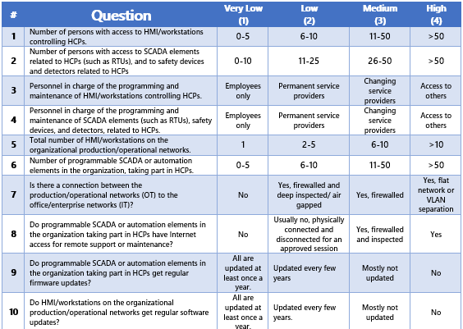
  Probability of Cyber Attack Questionnaire
(36 Questions)
High (4) | Medium (3) | Low (2) | Very Low (1) | Question | #
P
P = Average (1-36) = 1 to 4

Slide 33
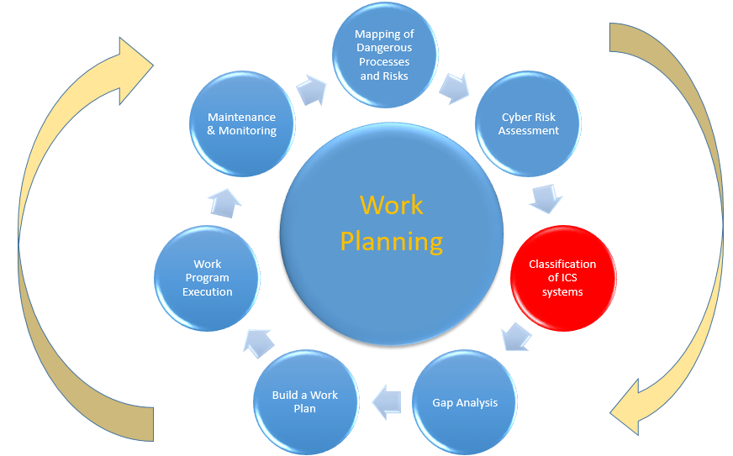
Step 3
Classification of ICS system
Heat Map
RISK | CONTROL PACKAGE | CONTROLS
4-7 | 1 | 41
8-11 | 2 | 59
12-14 | 3 | 81
15-16 | 4 | 92
Risk = P + 3*I

Slide 34
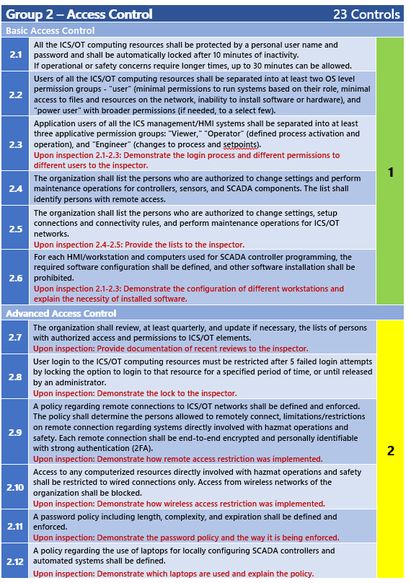
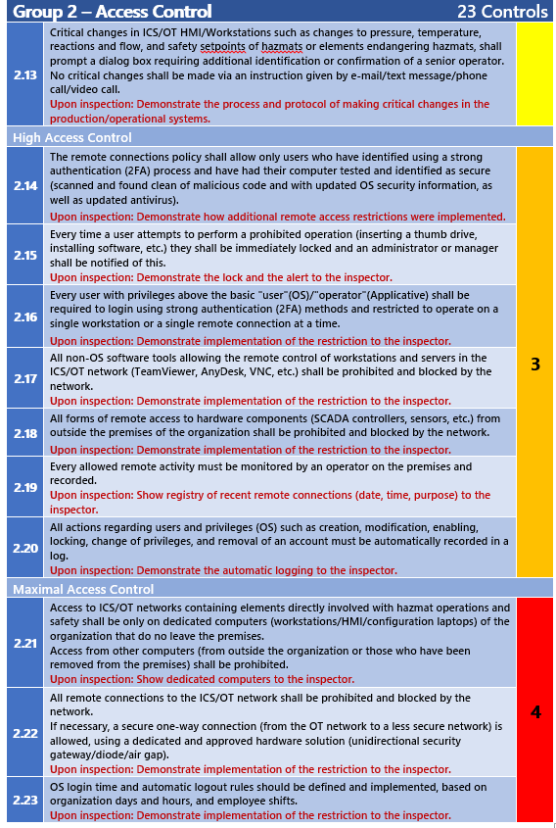
  Required Controls
PPT MODEL
P – People
P – Process
T – Technology

Slide 35

Step 4
    Gap Analysis
Required controls received from the risk assessment process
Existing controls at the plant before risk assessment is carried out
http://www.robi-steiner.co.il/why-there-is-a-gap
Notes:
For each of the controls on the list, the organization shall identify whether that control is currently fully implemented, partially implemented, not implemented, or irrelevant (such as a control of updating PLC firmware when no PLCs are used in a mapped HCP).

Slide 36
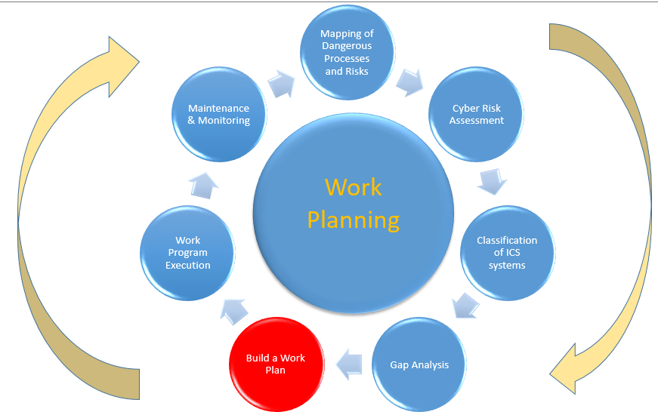
Steps 5
        Compiling a Compliance Plan
# | Required control | Status | Action items
2.1 | All the ICS/OT computing resources shall be protected by a personal user name and password and shall be automatically locked after 10 minutes of inactivity. If operational or safety concerns require longer times, up to 30 minutes can be allowed. | Partially implemented. No workstation locks. | IT - Simon needs to implement workstation locks by 31/12/2023.
2.2 | Users of all the ICS/OT computing resources shall be separated into at least two OS level permission groups - "user" (minimal permissions to run systems based on their role, minimal access to files and resources on the network, inability to install software or hardware), and "power user" with broader permissions (if needed, to a select few). | Not implemented. | IT - Debby needs to implement workstation OS user levels by 15/11/2023.
2.3 | Application users of all the ICS management/HMI systems shall be separated into at least three applicative permission groups: "Viewer," "Operator" (defined process activation and operation), and "Engineer" (changes to process and setpoints). | Partially implemented. We have "Viewer" and "Engineer," not "Operator." | Great HMI Inc. – Derrek needs to implement HMI permissions by 20/10/2023.
Notes:
A Compliance Plan is a list of action items with target dates, which will ensure that the organization can comply with the MoEP's cyber security regulations within the allotted time.
The plan will show a roadmap to fully implement Required Controls currently not implemented or partially implemented, and the action items required to maintain implemented controls. For example:
During this stage, the organization may request permission from the MoEP Cyber Defense Unit to use Compensating Controls if the Required Controls are prohibitively expensive or technically hard to implement. During this stage, the organization may also propose ways to change its processes, such as adding manual safeties or ceasing the use of certain hazardous materials by the end of the allotted time, in order to reduce environmental risks, and thus be allowed to implement fewer controls.

Slide 37

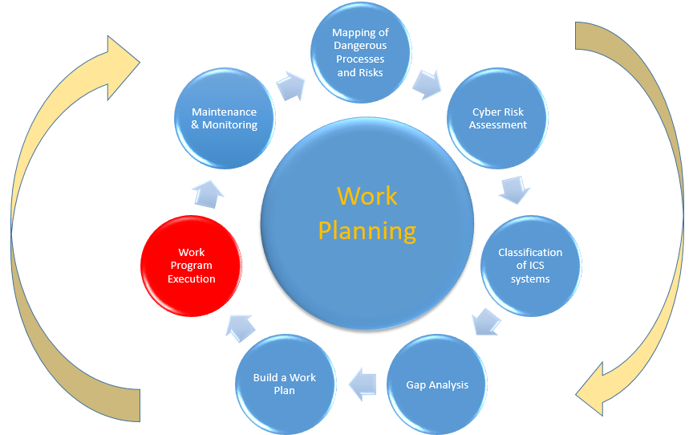
Step 6
Work Program Execution
The organization shall execute the Compliance Plan.
During this process, the organization shall update any necessary operational processes and protocols, as well as the organizational Cyber Security Policy.
https://www.pexels.com/

Slide 38

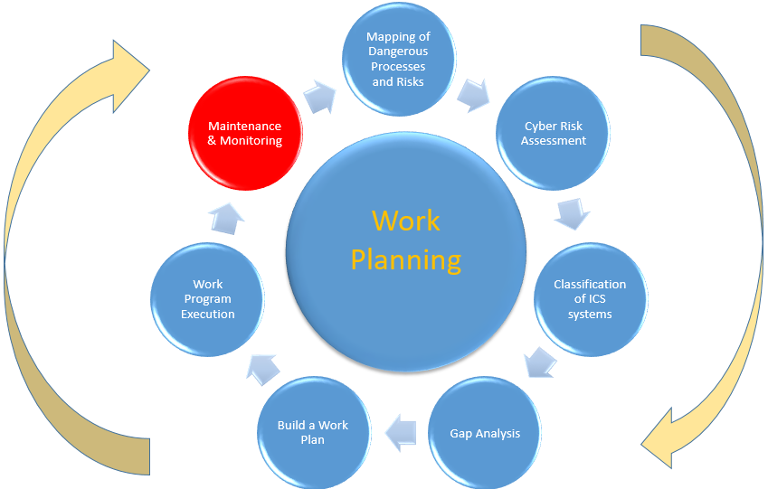
Step 7
Maintenance & Monitoring
https://www.pexels.com/

Slide 39



Challenges

Slide 40


Challenge No 1: ICS Security Lack of Expertise
In order to be a cyber expert in hazardous material industry, the following specializations are required:
IT & OT CYBER SECURITY EXPERT
IT
OT
IT SECURITY
ICS sec
ICS ENGINEERING
Cyber Ecologist??
Hazardous Materials

Slide 41
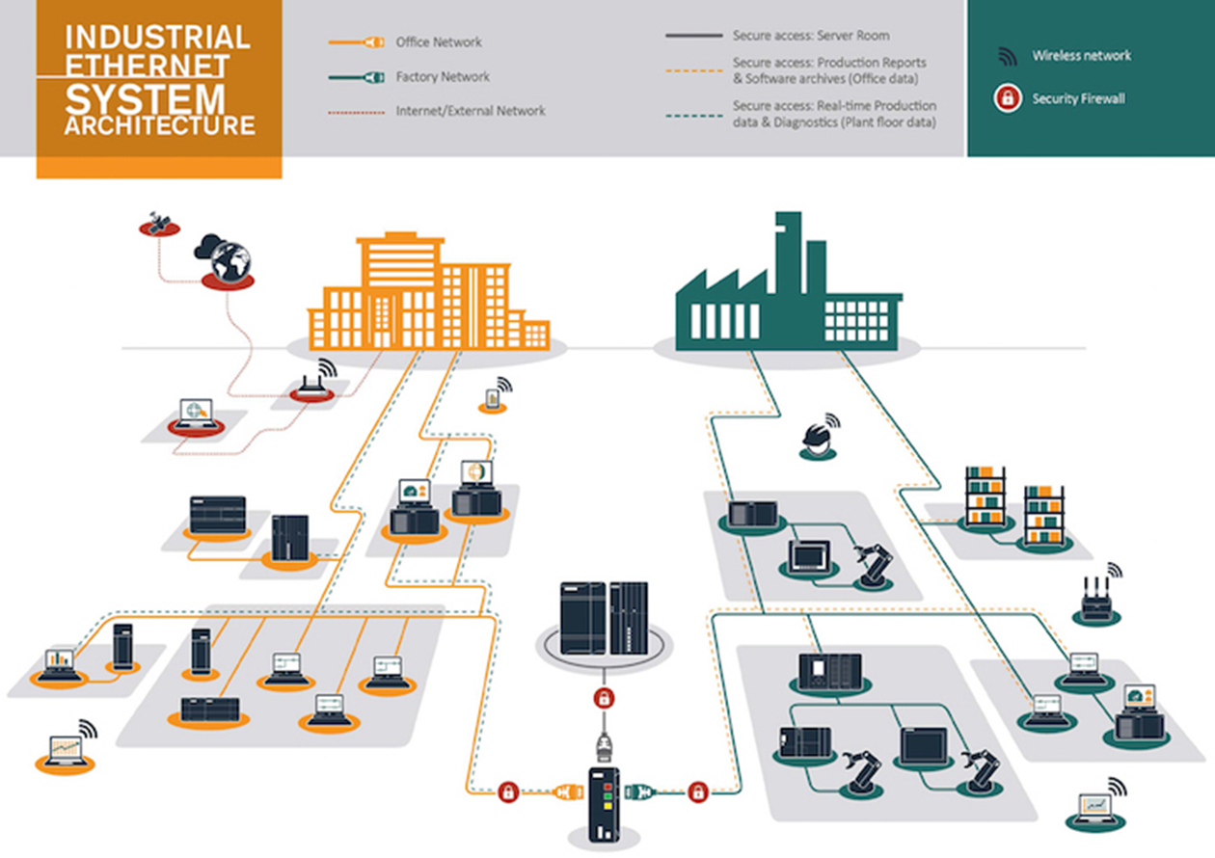
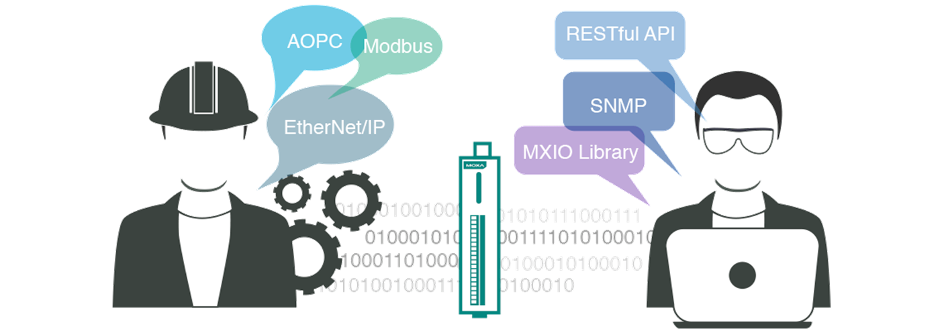
Key challenges for implementing the work plan
Separation of IT - OT networks
IT - OT Teamwork Collaboration
Operation Manager
(OT CISO??)
CISO
Source:
http://www.iebmedia.com/ethernet.php?id=10944&parentid=74&themeid=255&hft=88&showdetail=true&bb=1
Source:
https://www.moxa.com/Event/DAC/2017/multiprotocol-smart-io/index.htm

Slide 42



More Challenges
Supply Chain – The weak link of the chain
https://www.pexels.com/
Monitoring the OT network: SIEM-SOC systems
Awareness Tutorials- For the OT staff: operation manager,
Engineers, HMI operators etc.
https://www.pexels.com/
Procedures- Remote control (Encryption, 2FA ) , add/remove permissions etc.
https://www.pexels.com/

Slide 43

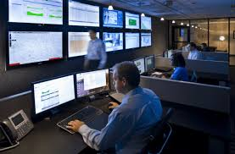
Regulatory Support Actions
In order to motivate and encourage the HazMat Industry:
Establishment of a Cyber Course for the Hazardous Materials Industry in collaboration with the Manufacturers Association (Within 4 days of registering the course was filled )
The course is full
A date for another course will be announced
Establishing SIEM SOC for the Hazardous Materials Industry (A system designed to monitor cyber incidents in factories )
https://steppa.ca/portfolio-view/steppa-siem/

Slide 44

Summary
As a result of all these actions, we will Increase the Resilience of the plants to a very high percentage within 3 years.
https://www.pexels.com/

Slide 45
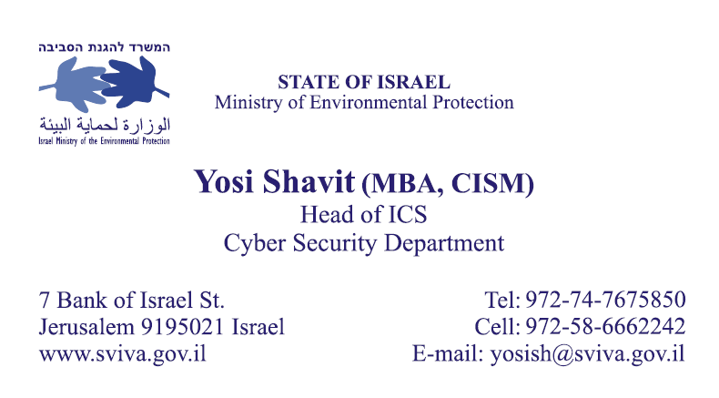
Thank You !

